Slide 1
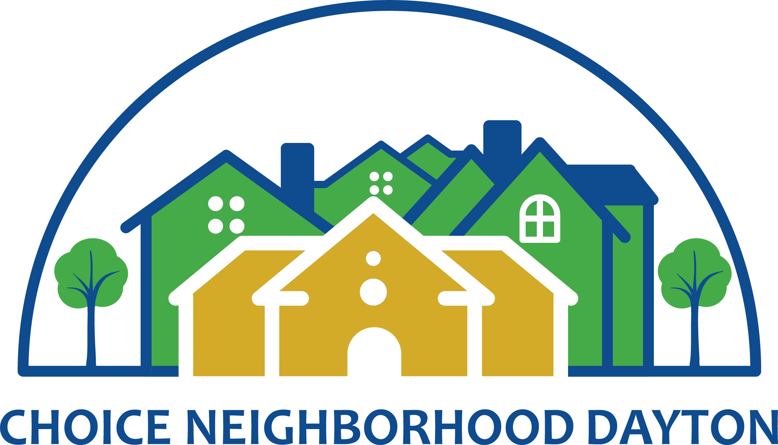
Choice Neighborhood Planning
Notes:
KP

Slide 2
CN: What is the Community Saying?
Household Needs Assessment (Public Housing Residents)
Community Assessment (Broader Neighborhood):
  179 of 441 heads of households
  (40.6%) participated
  Transportation is #1 barrier to work, also listed as top asset
  Top retail needs: grocery store, laundromat
  Safety: Most concerned about safety and want stronger police presence
  65% said there were times when there was not enough food in the house
  62% interested in on site community gardens
  Of respondents with preschool children, all are using high quality preschools. However, those in primary education most attend schools outside of neighborhood
  78 participants
  Most were retired or disabled participants
  Top retail needs: grocery, restaurants, farmers market
  Most felt safe, majority desire more visible police patrol (69%)
  Only 21% indicated there were times when there was not enough food
  55% interested in community garden
Notes:
Suggestion: during remarks note that highlighted items were verified through recent community visioning activity.

Slide 3
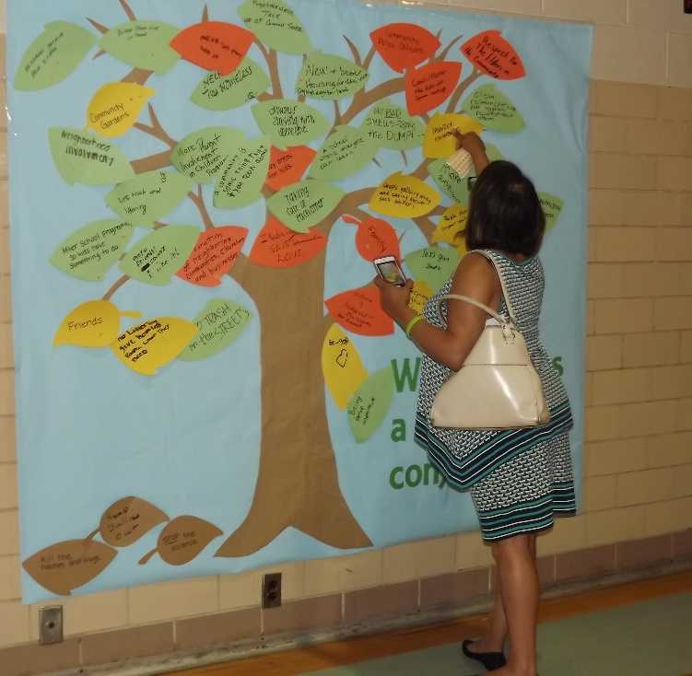
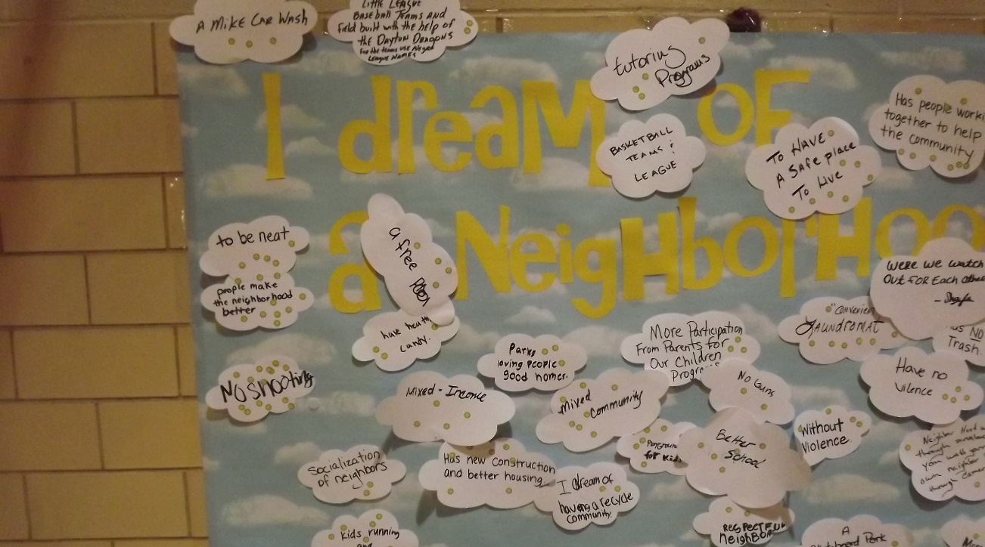
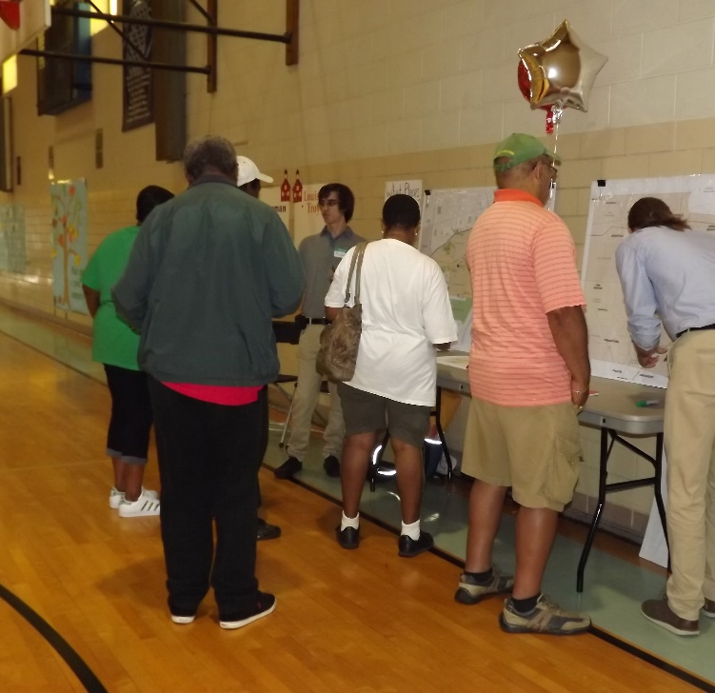
Community Visioning Party
Notes:
Event was held on September 21 to share results of nine months of planning and organizing in a fun way with residents. Over 100 people attended. Goal: where is there consensus? What is most important.

Slide 4
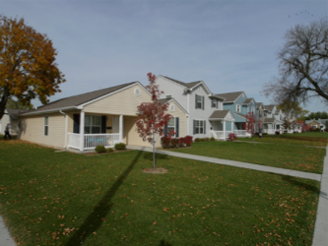
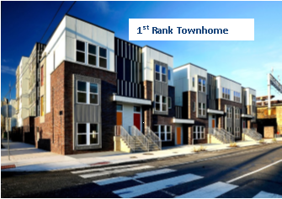
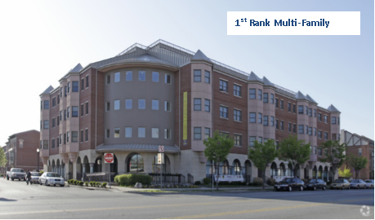
CN: What is the Community Saying?
Housing style preferences Family Housing Category
Notes:
Suggestion: during remarks note that highlighted items were verified through recent community visioning activity.

Slide 5
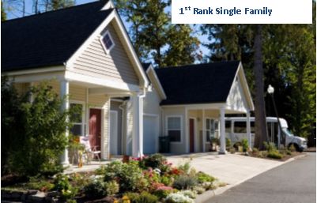
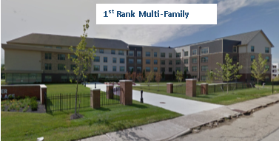
CN: What is the Community Saying?
Housing style preferences Senior Housing Category
Notes:
Suggestion: during remarks note that highlighted items were verified through recent community visioning activity.

Slide 6
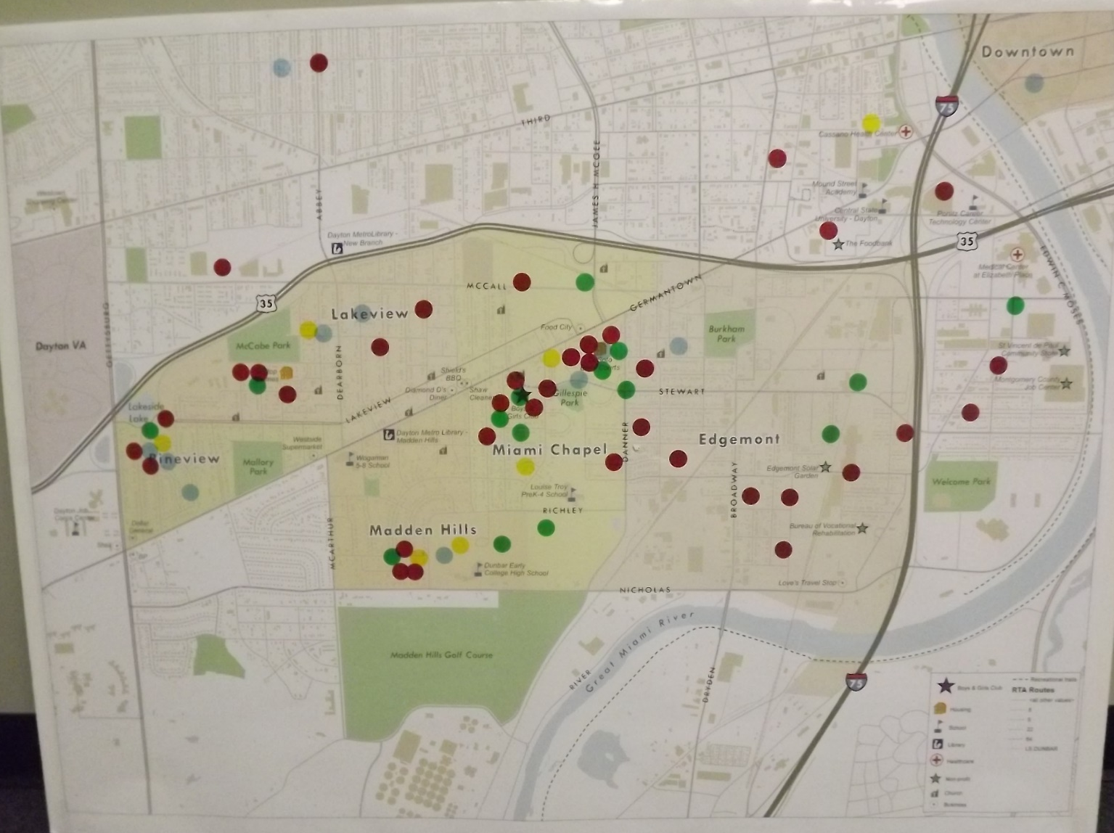
CN: What is the Community Saying?
Geographic Location preferences- Choice area map
  70 Selections
  21- DeSoto/Miami Chapel
  11- Hilltop
  11- Edgemont
  11- Outside Choice
  8 - Madden Hills
  8 - Pineview
Notes:
Suggestion: during remarks note that highlighted items were verified through recent community visioning activity.

Slide 7
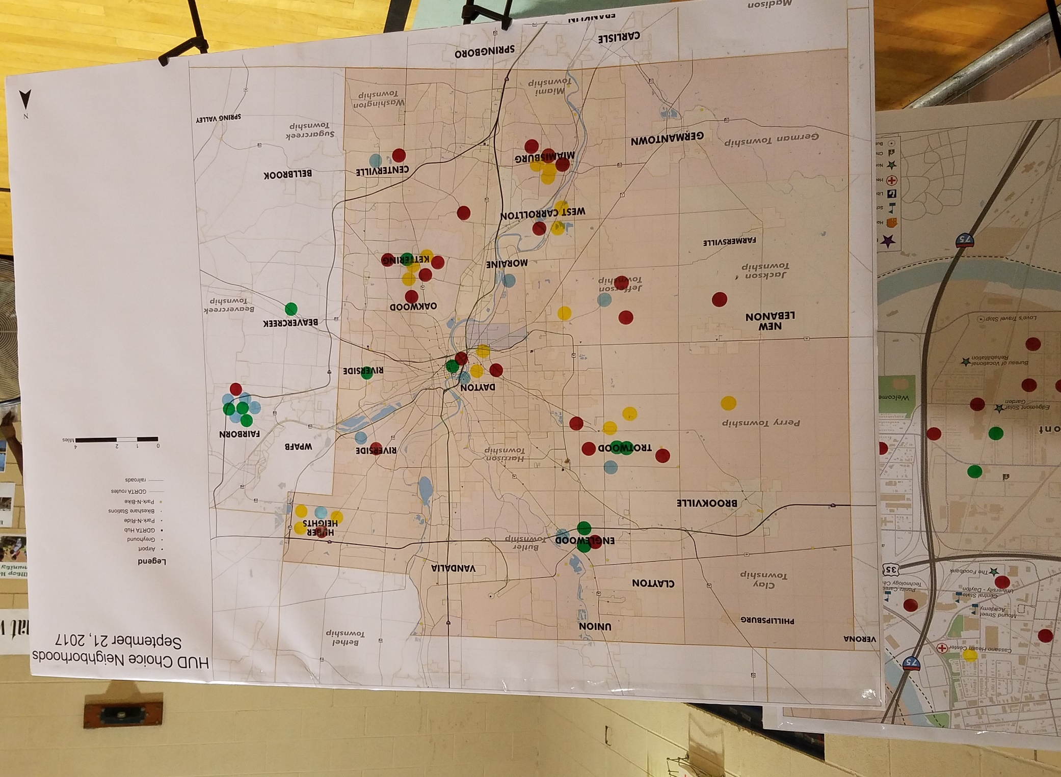
CN: What is the Community Saying?
Geographic Location preferences – County map
  62 Selections
  9 – Oakwood/Kettering
  8 – Trotwood
  8 - Fairborn
  6 - Miamisburg
  6 - Dayton
  5 – Huber Heights
  4 – Englewood
  4 – Jefferson
  3 – West Carrollton
  3 - Riverside
  2 – Centerville
  2 – Western Rural Area
  1- Moraine
  1 - Beavercreek
Notes:
Suggestion: during remarks note that highlighted items were verified through recent community visioning activity.

Slide 8
CN: What Does the Data Say about Housing?
Lead Entities: GDPM and Development Partner
Housing Market Study
  Key Findings Related to Demand
    Market Rate (Family/Senior) 70-100 units
    LIHTC (Family) 140-190 units (40-60% AMI)
    LIHTC (Senior) 50-70 units (40-60% AMI)
    Subsidized units (Family) 240-320 units
    (below 30% AMI)
    Subsidized units (Senior) 180-260 units
    (below 30% AMI)
    For Sale units, any 20-55 (80-120% AMI)
  Desired Amenities for housing
  (Central Air, dishwasher, microwave, stove, refrigerator, ceiling fans washers/dryers on site or in units;
  Connectivity
  Walkable
  Green space
  Recreation
  Retail options
  Well lit
Notes:
Projections of what market can support by 2020
(from organizing work and surveys)
kp

Slide 9
CN: Emerging Housing Strategies
Lead Entities: Housing Authority, MBS
Partners: Citywide, County Corp, Montgomery County Landbank
Housing Development Options
  Town Center Concept
    Build new Gateway; a bold sign that something is different
    Development option: paired buildings at James H. McGee and Germantown
      Possible mixed use, retail first floor with housing atop
    Wrap around the corner to add new housing across for Desoto Bass
    Incorporate history and culture in design
  Louise Troy Area Housing Development
    Build on work of Habitat in this area
  Germantown Village Phase II
    Build Phase II along Germanton leading into Choice area
  Germantown Business Corridor
    Strengthen Germantown business corridor from Stewart to Lola Street through streetscape enhancement and support to small businesses.
Notes:
From surveys, community organizing work, committee work. Visioning sessions will start 9/21
Kp- add housing results from visioning

Slide 10
CN: Neighborhood
Lead Entities: Citywide
Partners: City, MVRPC, RTA, County Corp, Montgomery County Landbank, GDPM
Data collection and GIS mapping
  Housing conditions
  Vacant Land Inventory
  Infrastructure
  Investment
  Community Assets
  Transportation
West Dayton Corridor Plan Adopted
  Choice footprint a focus of the Corridor Plan
  Makes recommendations for infrastructure improvements
  Helps secure points for competitive transportation dollars that can leverage other development dollars
  Vision what is possible....
Notes:
Karen

Slide 11
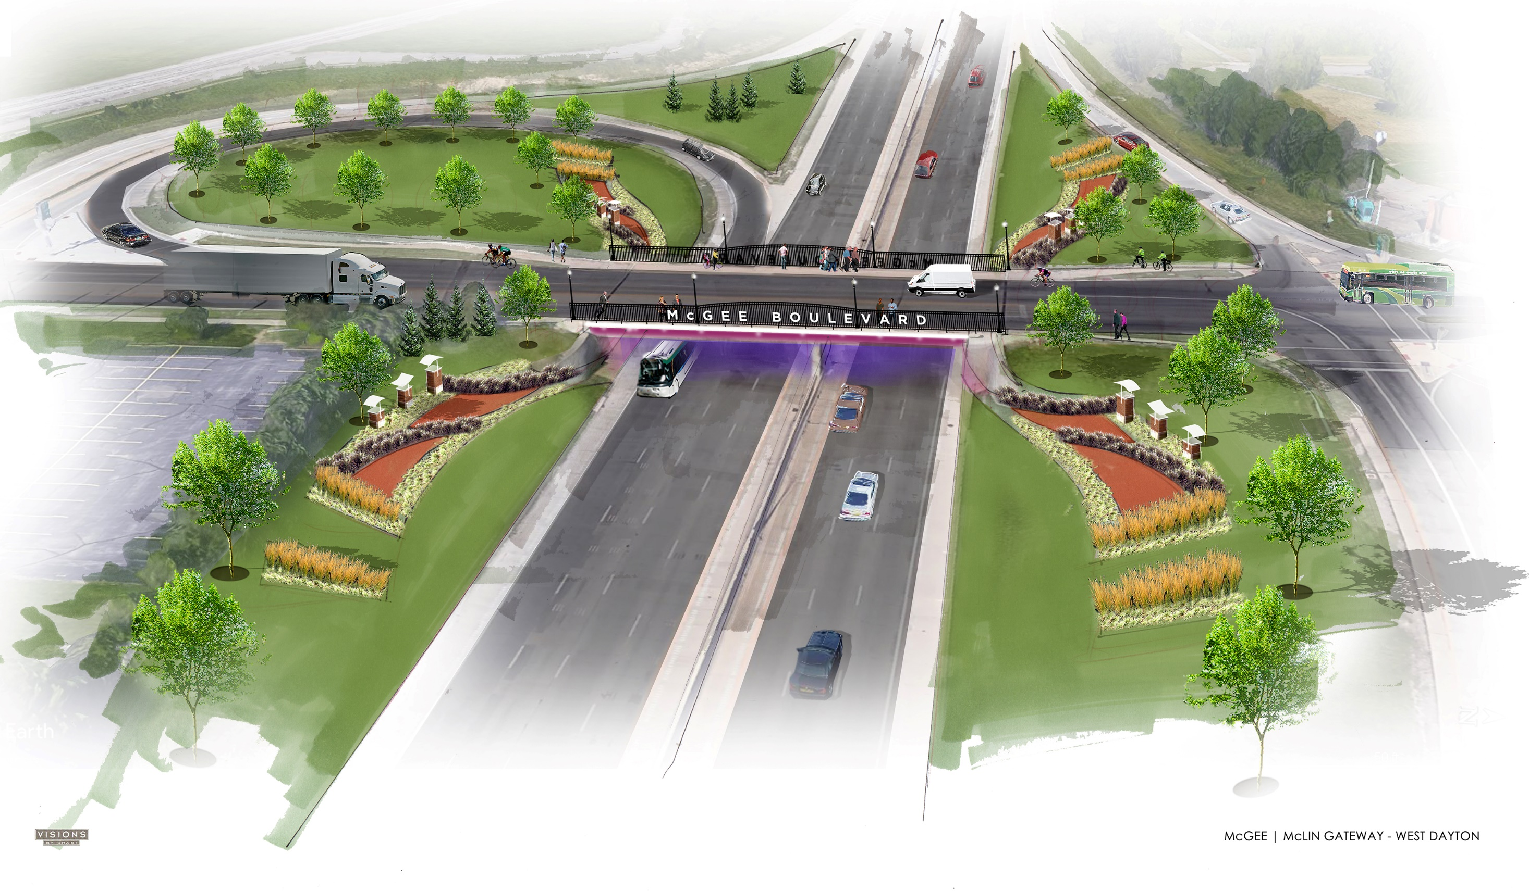
Notes:
New gateway at James H. McGee and US 35 Karen

Slide 12
CN: Emerging Neighborhood Stabilization Strategies
Pineview and Madden Hills Neighborhoods (prevent tipping)
  Support to homeowners – home improvement/DPA/rehab
  Strategic Demolition
  Community Organizing and Projects – build relationships, get something done
  Development planning for new housing in the future (market driven)
Rezone some areas of high blight and vacancy to open space
  Extend McCabe Park
  Create Urban Forest
  North of McCall Street – commercial
Infrastructure
  Realign key streets
    James H. McGee Boulevard to Nicolas Road – creates more option for Stewart Street
    Choice Assets
    MacArthur – create true entrance into Madden Hills
    Dearborn Improved to Abbey
Notes:
Tipping in this case means decline Karen

Slide 13
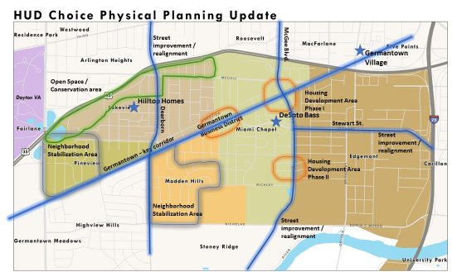
CN: Emerging Neighborhood
Stabilization Strategies
Notes:
Karen

Slide 14
CN: People- Community Engagement
- Over 300 people engaged through community meetings and events
- Approximately 8 meetings formal meetings held
- Resident Councils Formed: Hilltop Homes and Desoto Bass
- Regular engagement with established neighborhood groups in Pineview and Madden Hills
- Monthly newsletter, website, Facebook
- Subcommittees formed based on organizing work and data:
  Education: led by the University of Dayton
  Safety: led by HRC
  Youth: led by CityWide
  Community Gardening: led by CityWide
  Health/Employment: GDPM-FSS, Public Health, CareSource others TBD
Notes:
Karen

Slide 15
CN: Emerging People Strategies
Lead Entity: Housing Authority FSS (tentative)
Partners: Univ. of Dayton, CareSource (JobsPlus), Citywide, HRC, others TBD
Education: align Choice education with Learn to Earn, Preschool Promise and City of Learners. Strengthen local schools by developing robust after school programs and parent involvement events.
Employment: align JobsPlus services by contacting clients to local employers; develop pilot projects with willing companies.
Safety: consistently the most important issue to residents and larger community with emphasis on community policing.
Economic Development: support to small businesses and revitalization of Germantown Business District.
Notes:
I would approach his by describing these as emerging strategies coming from nine months of planning and organizing work.

Slide 16
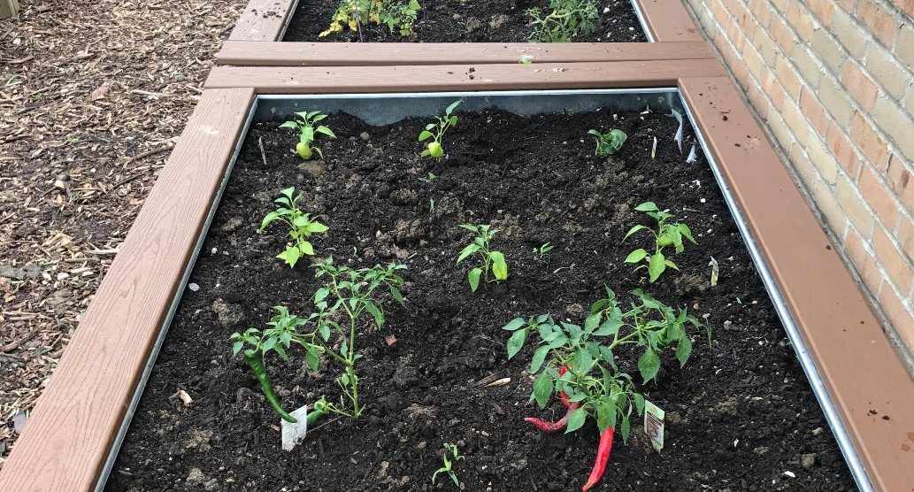
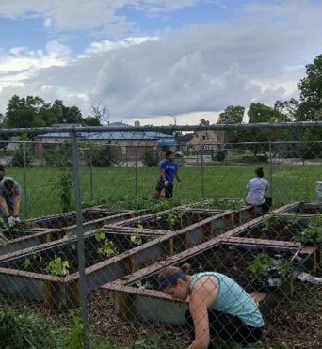

CN: Early Action Activities
Notes:
DeSoto Bass Community Garden- with leverage funding from Citywide. The logo and name were created and voted on by residents
kp

Slide 17
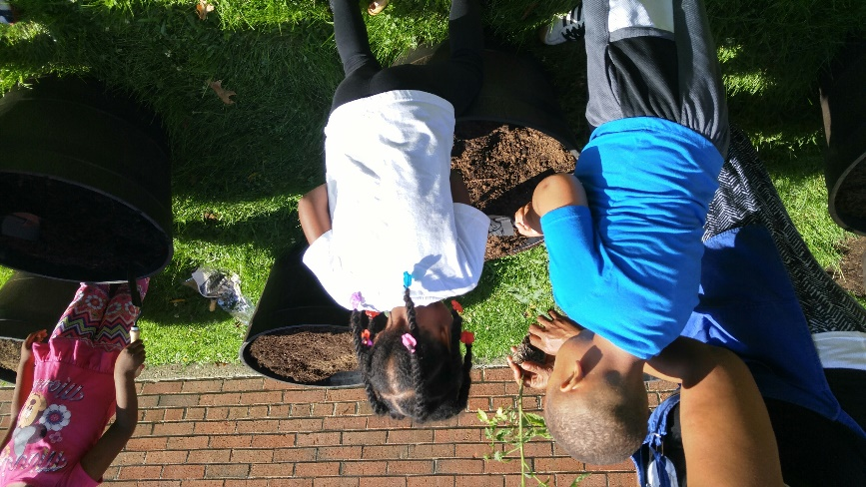
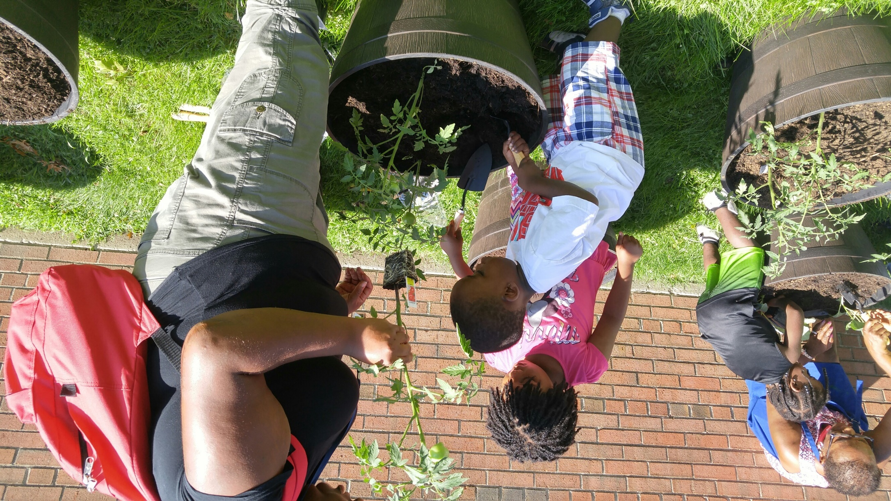
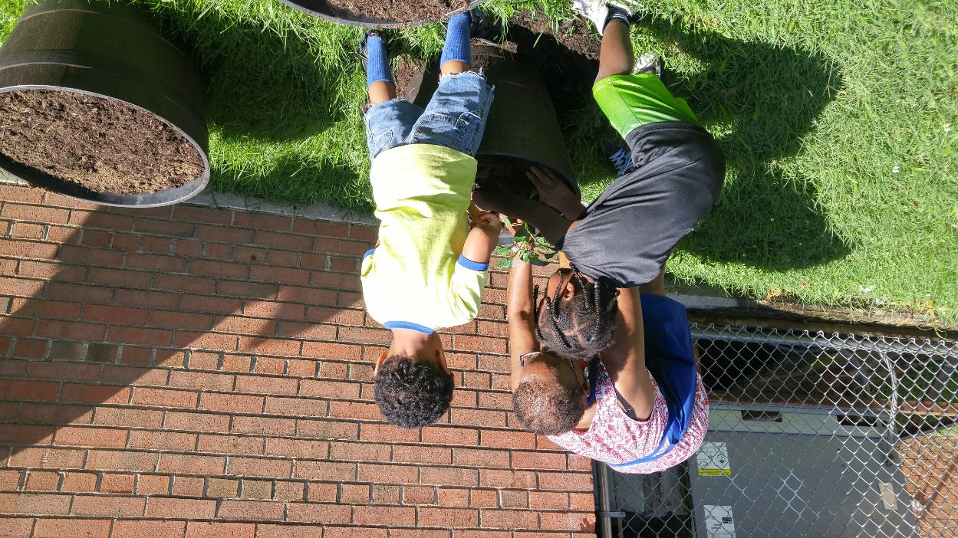
Hilltop Container Gardening
Partners
Miami Valley Child Development
Hilltop Residents
CityWide
CareSource -Healthy Buckeye Grant
Notes:
Hilltop Container Garden

Slide 18
Edgemont Solar Garden
Total Cost : $160,000
$48,000.00 – CDBG
    Other leverage funding
Partners
Homefull Farm - Installation of high tunnel hoop house at Homefull Farm
Edgemont Solar Garden -infrastructure improvements; electrical work necessary to generate hoop house functionality; community garden and horticultural consultation and technical assistance.
Main & Helena Community Garden- improvements and enhancements to the hoop house; improvements and enhancements to the garden via construction of additional raised beds and gardening plots; operate and maintain the garden; community garden and horticultural consultation and technical assistance
Notes:
Hilltop Container Garden

Slide 19
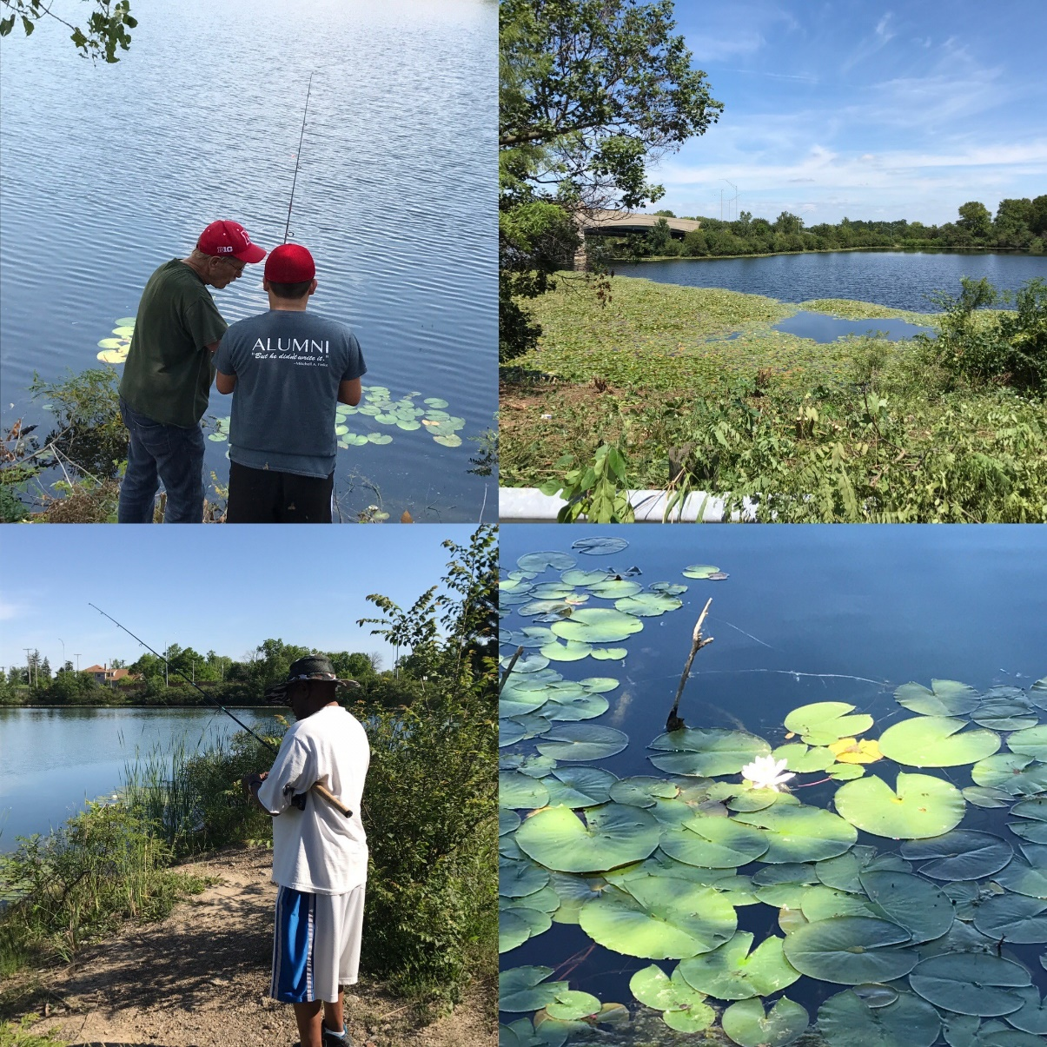
Lakeside
Restoration
CityWide
Pineview Neighborhood
GDPM
COD
State AFL-CIO
Union Sportsmen Alliance
Dayton VA
Garden Club of Dayton
UD River Stewards

Slide 20
CN: Emerging Action Activities
Germantown Corridor Streetscape Redevelopment
  Build new gateway at James H. McGee/US 35
  Enhance business district viability with streetscape improvements
  Business Façade improvements
  Establish 1-2 “pop up” business spaces for small entrepreneurs
  Add new laundry facility
  Rebuild Food Save and add public art mural on side of building (Germantown/JHM)
Choice Neighborhood Stabilization Program Phase 1- Pineview/Madden Hills
  Home Improvement
  Down payment Assistance
  Emergency Repairs
  Strategic Demolition
Notes:
KP & Karen

Slide 21
CN: Opportunities for Investment
Choice Phase 1 Neighborhood Stabilization
Leverage - $1M Choice Action Funding
Housing Stabilization/Growth
  Home Improvement Loans
  Down payment assistance/First Mortgages
  Strategic Acquisition/Demolition
  Purchase Rehab 203K Product
  Housing Counseling Support
  Economic Development
  Small business lending
  Construction capital/philanthropy : laundry
Neighborhood Improvements
  New Gateway
  Streetscape Improvements
Services to support Neighborhood Revitalization Efforts
  Community Policing
  Afterschool and summer youth programming
Germantown Corridor Streetscape redevelopment with laundry & public art
Notes:
KP & Karen

Slide 22
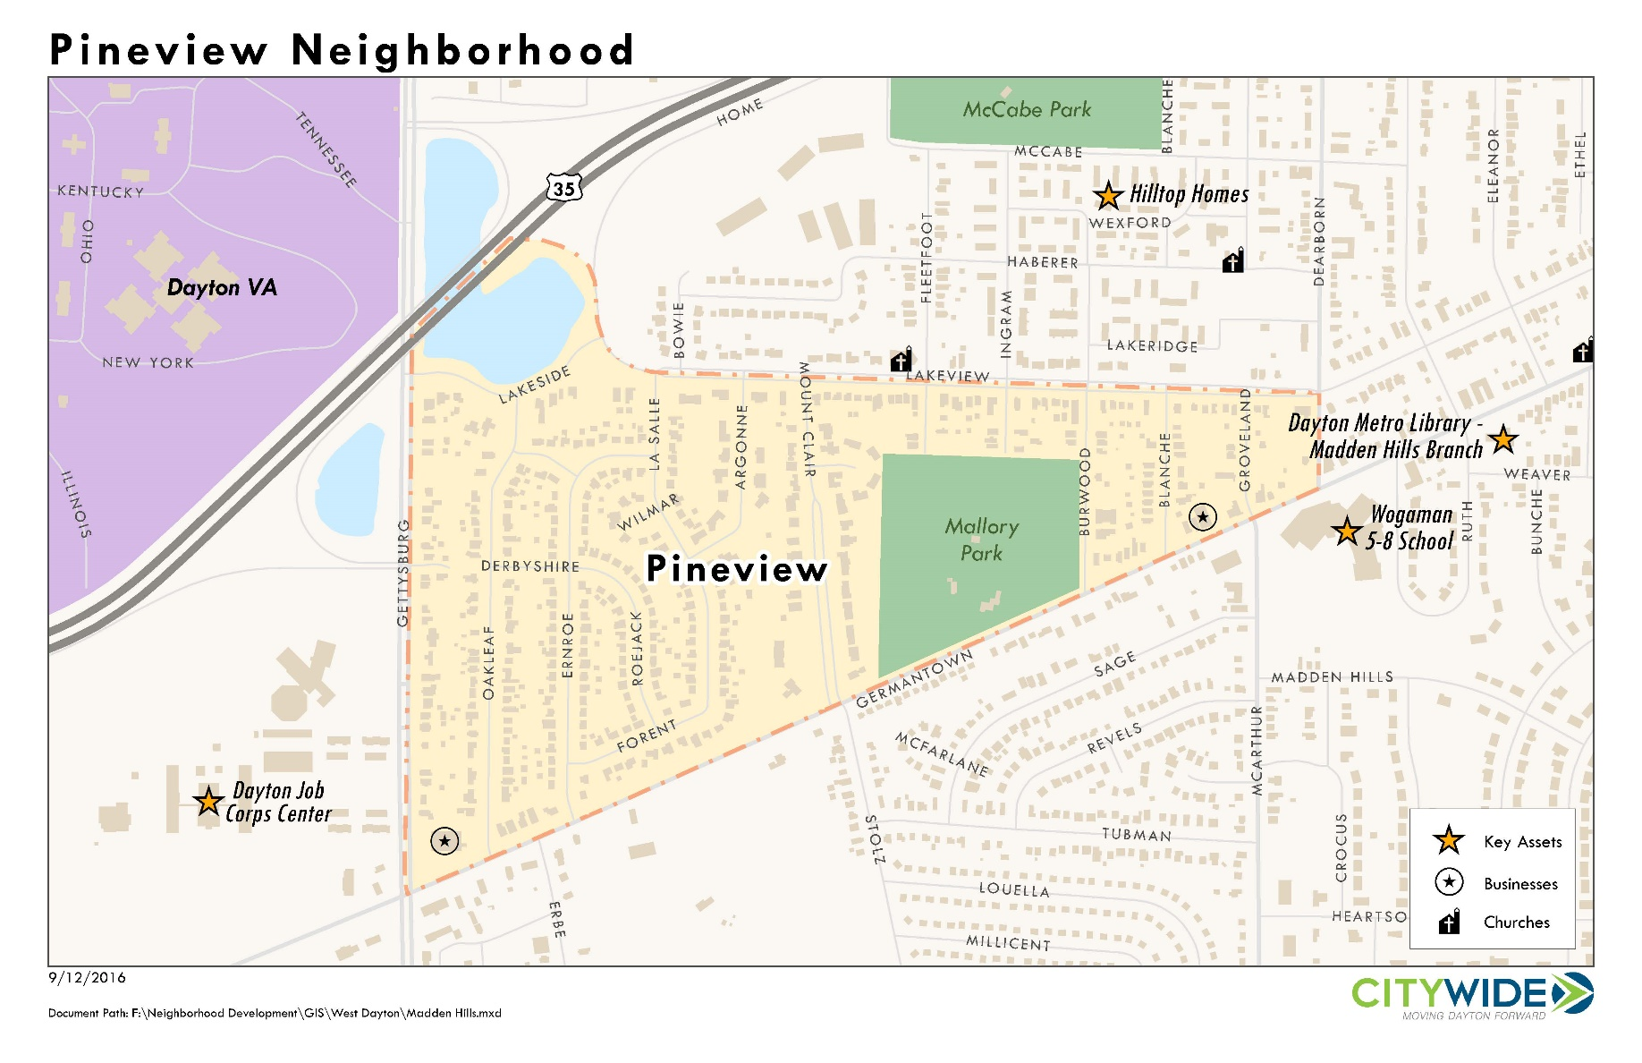
Housing Stabilization
Notes:
Landbank discussion of housing stabilization strategies for Pineview in partnership with CC, HOC, CW, etc. Could then reference Madden Hills as a companion neighborhood perhaps just popping up map so folks are oriented. Next slide

Slide 23
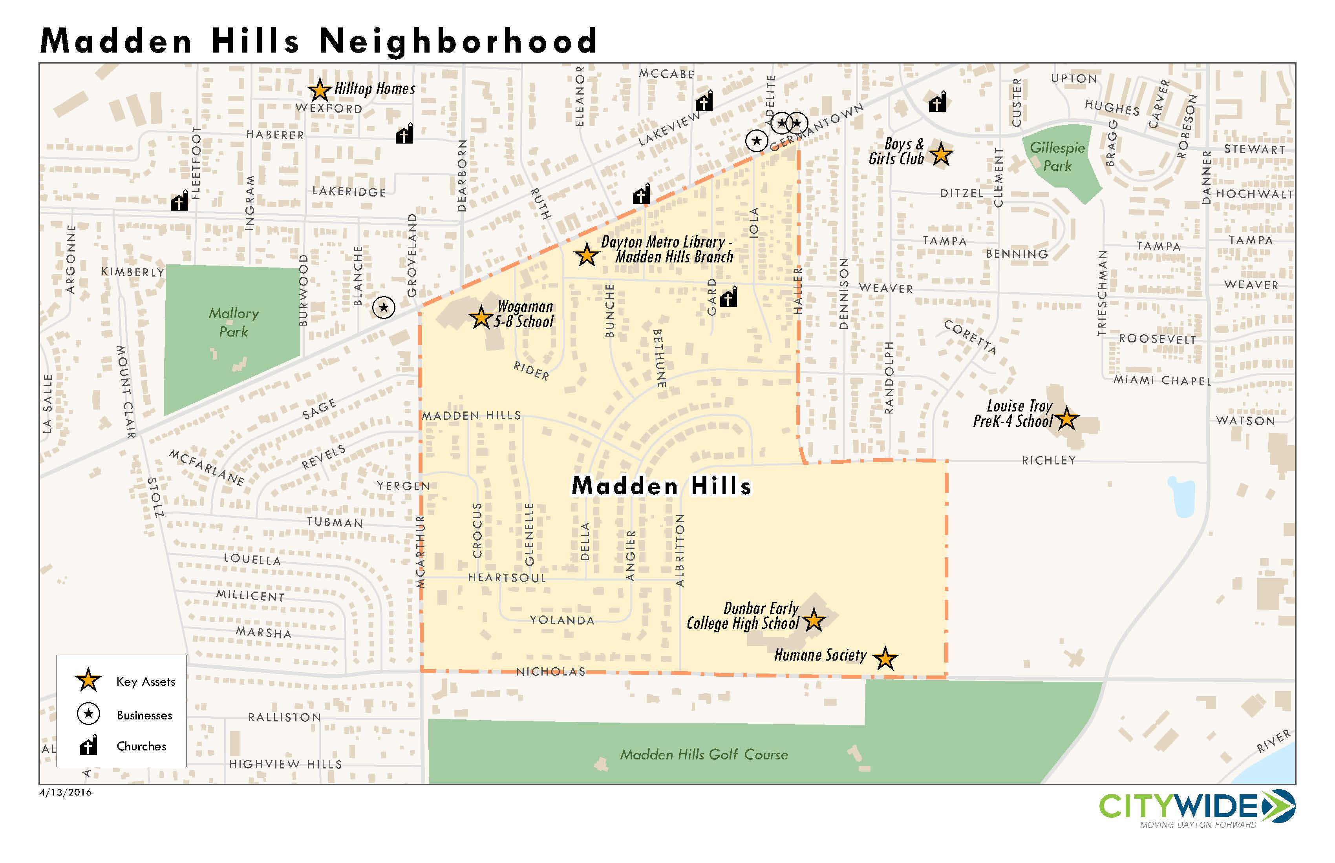
Housing Stabilization
Notes:
Can bring these programs to Madden Hills with appropriate support

Slide 24
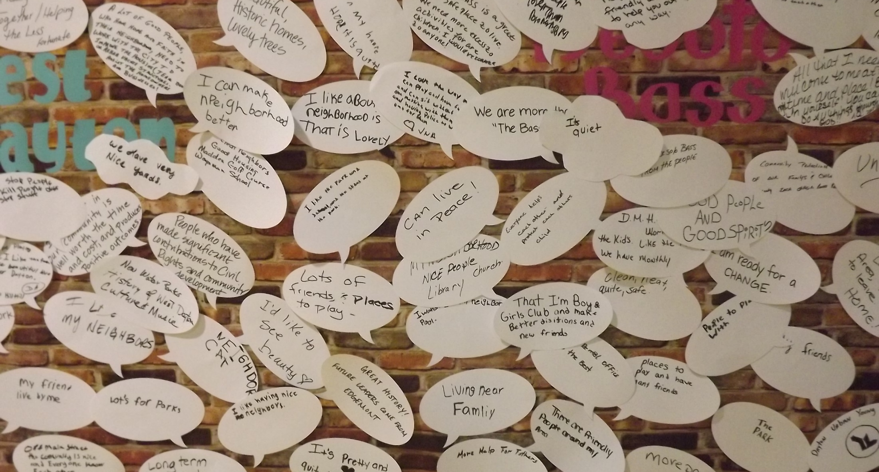
INVESTMENTS DEFINED
Notes:
Pass out spreadsheet and discuss investment opportunities.

