Slide 1
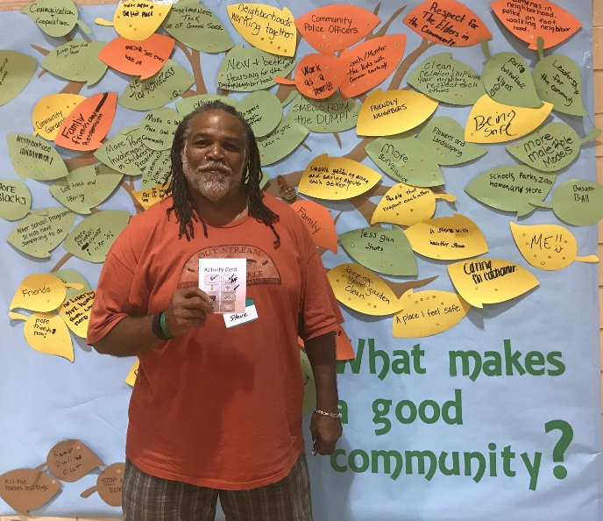
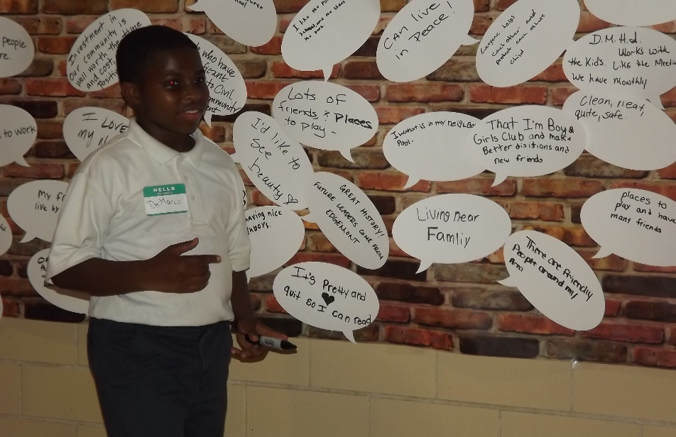
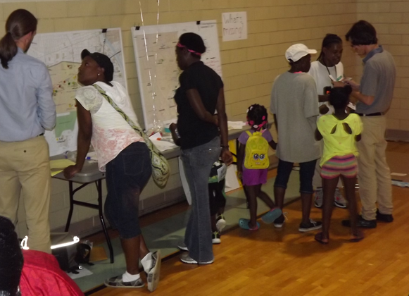
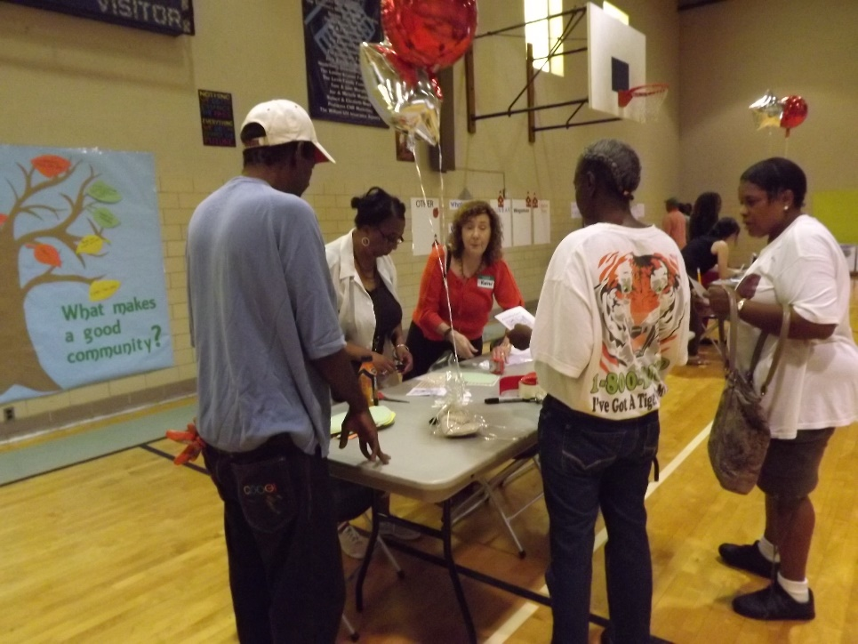



RENEW MIAMI CHAPEL UPDATE ~ JULY, 2018
Choice Neighborhoods DAYTON

Slide 2
Vision Statement
Our home, our community, our neighborhood...
  Our home is comfortable, with friendly and respectful neighbors
  Our community is thriving with access to opportunity, inspired businesses and good jobs
  Our neighborhood is a safe place to live with modern and affordable housing options

Slide 3
Top Six Priorities
Housing
The neighborhood is renewed with high-quality, sustainable, mixed income housing options.
Identity
The community is proud of the neighborhood and others recognize it as a positive place.
Education
The community is improving educational outcomes for children and proud of its schools.
Well-being
The community feels safe and is secure in their mental and physical well-being.
Asset & Economy Building
The neighborhood has better job access, stronger social connections, increased wealth, and celebrated amenities.
Transportation
The neighborhood is vibrant and well-connected for all modes of transportation.
Notes:
The plan has 9 chapters. Each of the 6 priorities has a dedicated chapter. Three additional chapters provide contextual information such as history & demographic data, the community engagement chapter details engagement process & how the plan was informed by the input received; and an implementation chapter describing the path to implementing the plan.

Slide 4
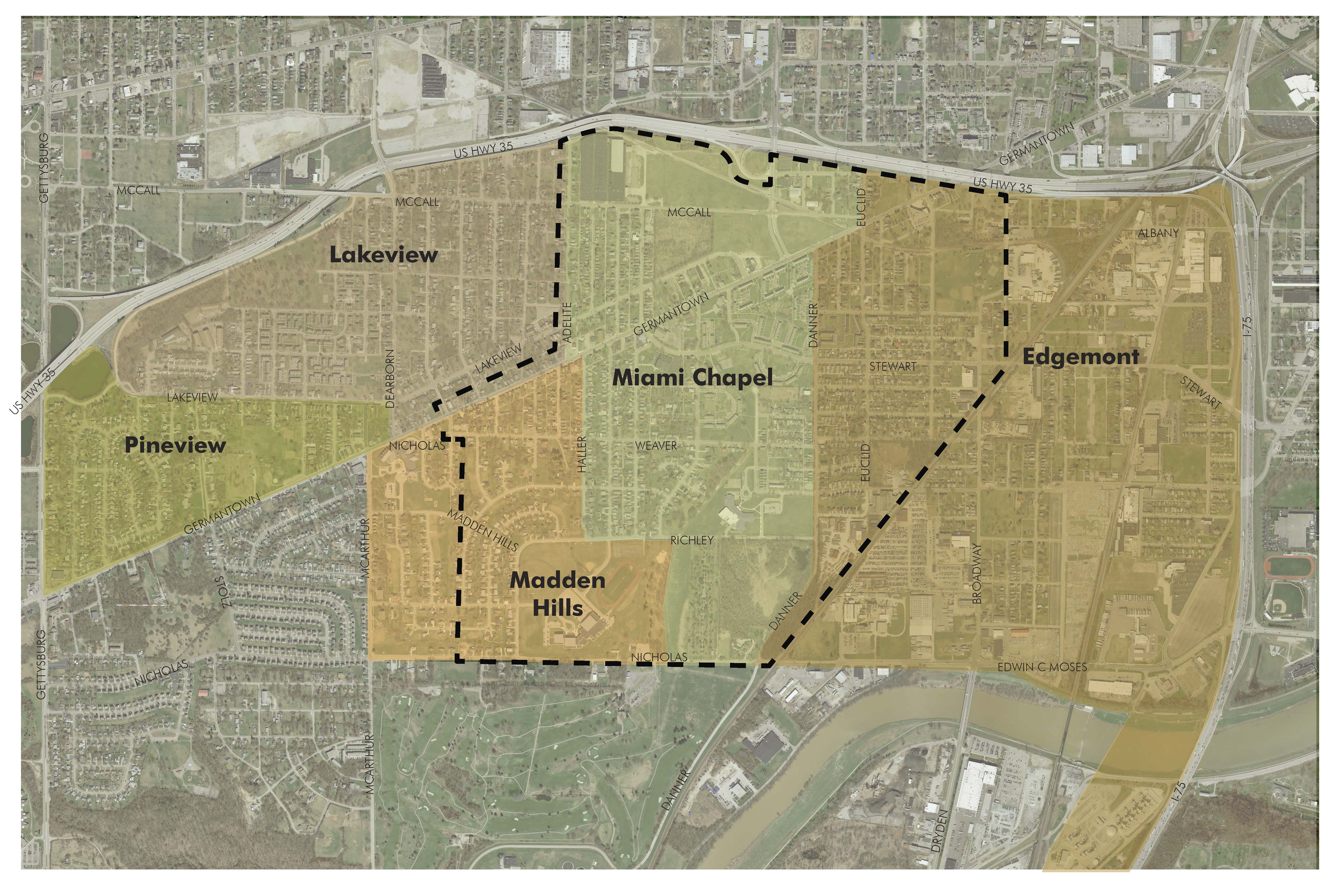

Slide 5
Overview of housing plan
Lead Entities: GDPM, Woda Cooper
Key Partners: City of Dayton, Land Bank, County Corp,
Habitat for Humanity, Rebuilding Together Dayton
Notes:
4 Housing Goals

Slide 6
Housing Goal #1
Redevelop the DeSoto Bass site to better connect the site to the Miami Chapel neighborhood and become a place where people choose to live
Objective 1: Redevelop DeSoto Bass as a preferred living community with appropriate density, housing types, and amenities that support development along Germantown
Objective 2: Redevelop homeownership units within Greater Miami Chapel near existing assets
Objective 3: Use new housing design and construction to promote active living

Slide 7
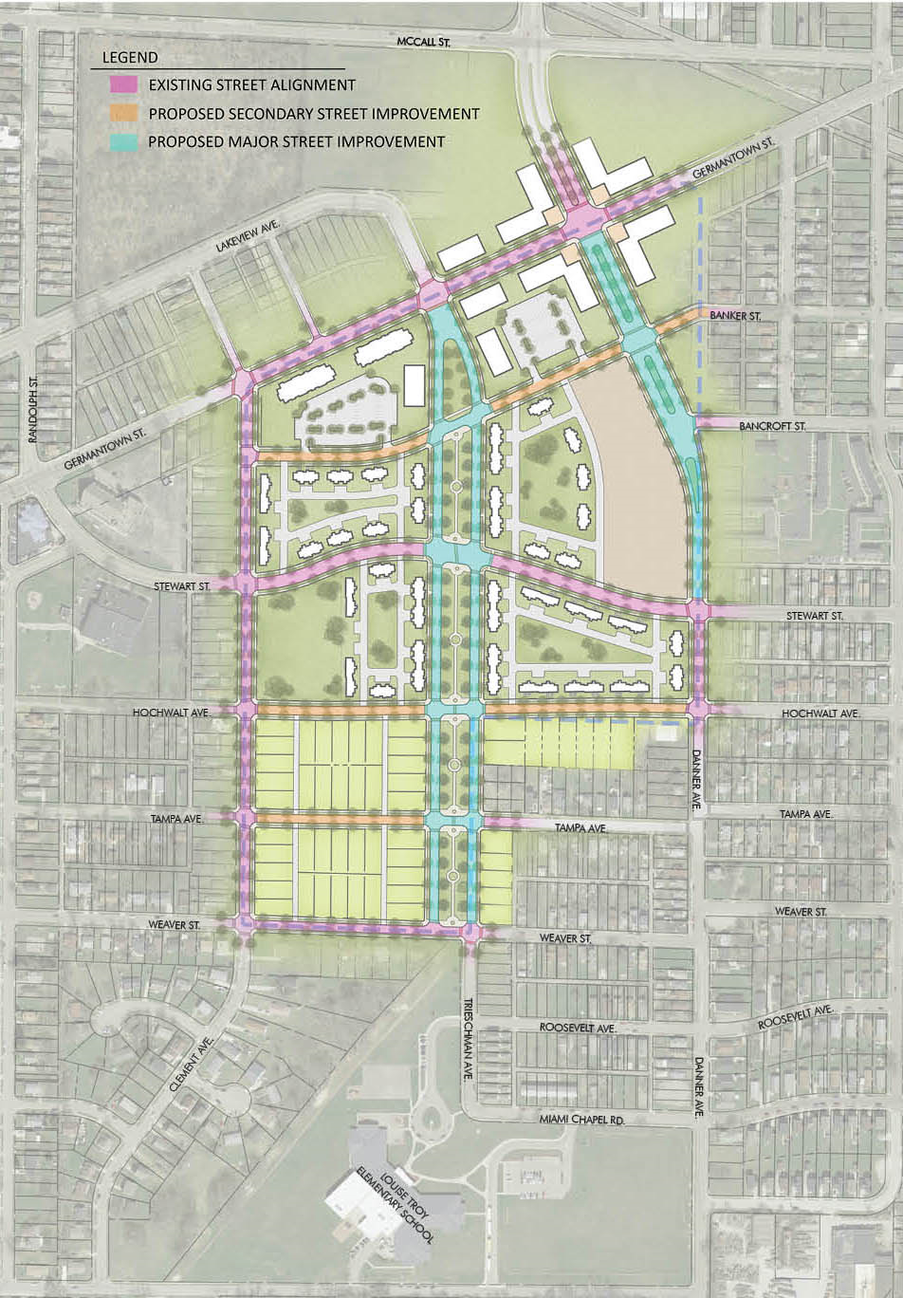
Notes:
connections design:
-Create hierarchy of streets, -Improve pedestrian walkability & connectivity, -Creating a safe route to school, -Reinforce residential character of streets, -Add green elements to the major streets
-Maintain Stewart Road Connection, -extend/complete the east/west streets in the single family portion of project. Also a table to review this more in depth and offer input

Slide 8
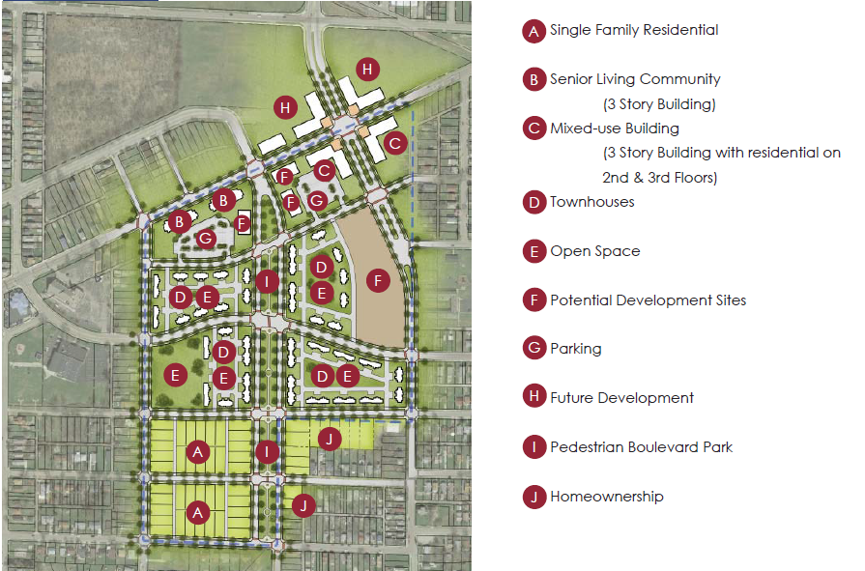

Slide 9
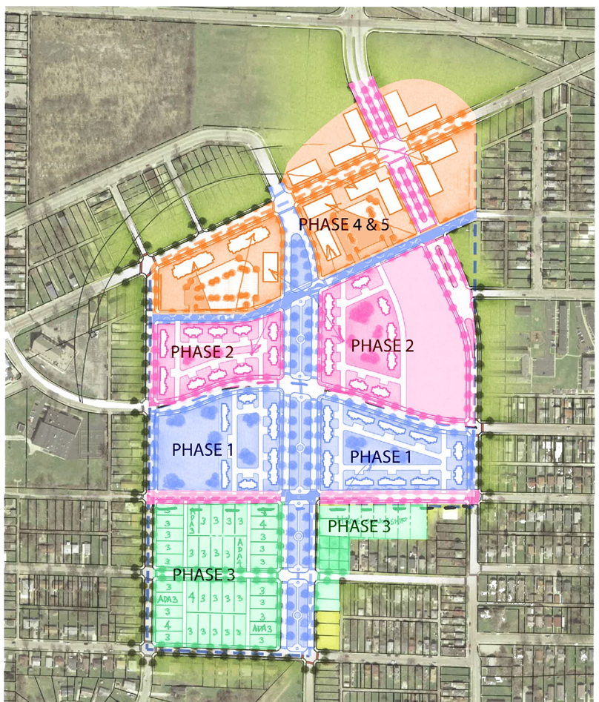

Slide 10
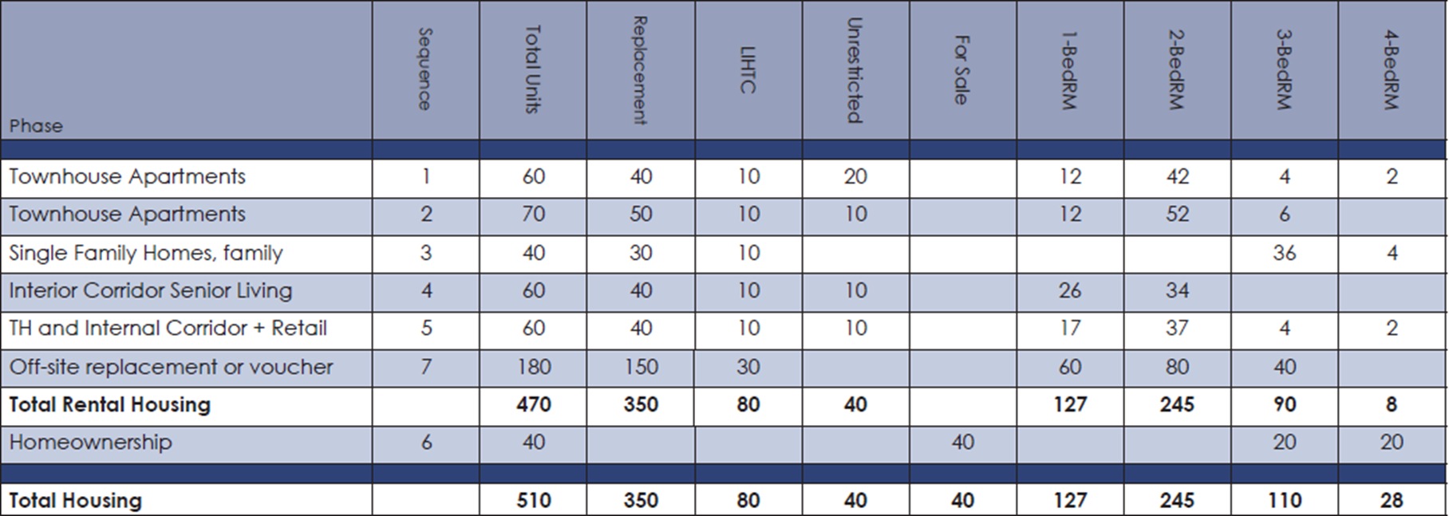
Phasing
Unit Mix

Slide 11
Phasing
Estimated Costs
Phase | Infrastructure | Infrastructure Costs | Total Development Costs
Townhouse Apartments Phase 1 | Lakeview Parkway & Banker Street | $2,400,000 | $9,600,000
Townhouse Apartments Phase 2 | James H McGee Extension to Danner & Hochwalt Ave Extension | $3,340,000 | $11,500,000
Single Family Homes-family Phase 3 | Remaining Road improvements (Bancroft & Tampa) | $2,275,000 | $9,750,000
Interior Corridor Senior Living- Phase 4 |  |  | $9,500,000
TH and Internal Corridor + Retail- Phase 5 |  |  | $9,800,000
Hilltop Demolition
Homeownership Phase |  |  | $5,200,000
Replacement of 100 units off-site |  |  | $20,205,000
Total | $88,735,500 | $8,015,000 | $75,555,000

Slide 12
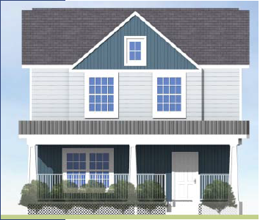
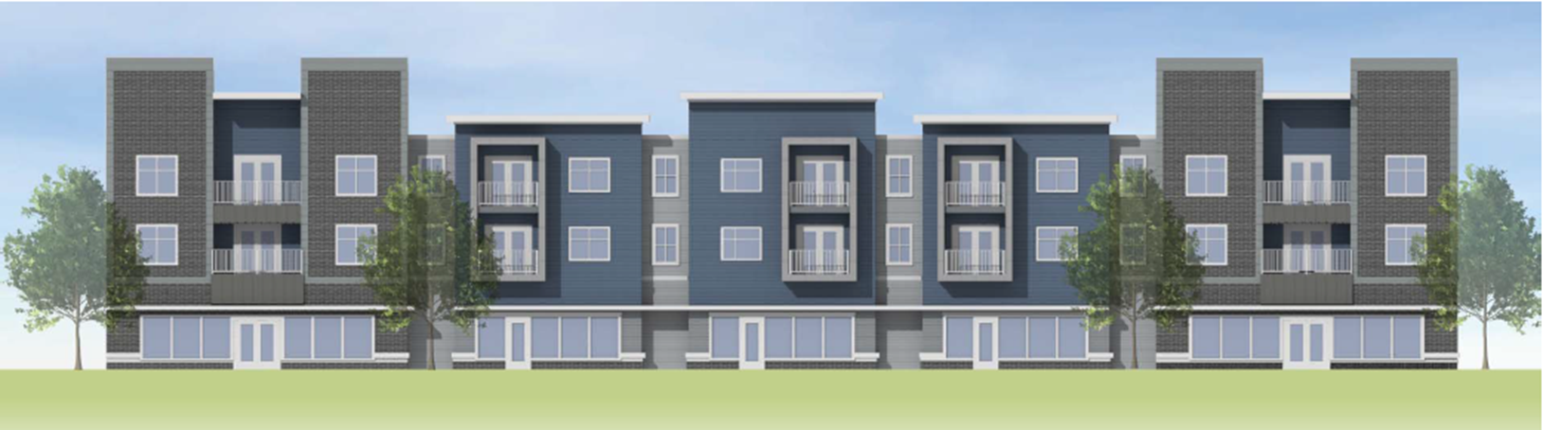
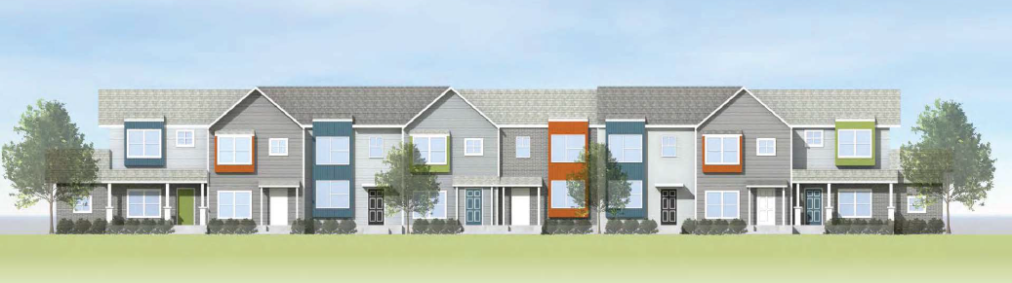
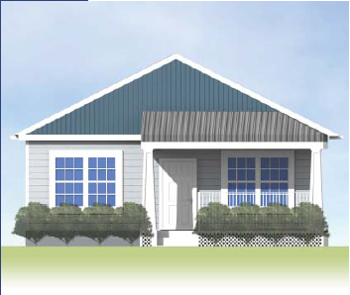
Proposed Elevations

Slide 13
Housing Goal #2
Reduce the density of subsidized housing in Greater Miami Chapel and provide residents with more housing options
Activities:
250 restricted income units replaced on-site
40 unrestricted income units added on-site
40 new homeownership units added near the site
Develop remaining replacement units off-site:
  Higher opportunity areas
  Housing Choice Voucher
Expanded Relocation Support
Expanded landlord recruitment for HCV program
Engage with partners such as ABLE for transparency of tenant rights
Notes:
Current density approximately 7.8 units per acre @ 350 units per 45 acres. Proposed density approximately 6.4 units per acre @ 290 units per 45 acres. Previous density approximately 11.1 units per acre @ 500 units per 45 acres. ~similar to density currently at Germantown Broadway tax-credit development. The proposed density fits in with the surrounding character and none of the proposed heights are greater than the max of 50 ft. per CoD zoning code.
The proposed density can supply a bus line, but is on the low end. Most online sources claim refer to this level of density as sufficient for a 30 minute bus stop frequency, however ours currently supports around a 15 minute peak time, so we may see a small hit in bus frequency eventually.
The proposed development type and density fits with the smart code v 9.2’s description and density range of a T4 general urban zone.
Because of the Choice requirements, our narrative needs to shift a little. Really, to be competitive, we won’t reduce the density of units in the area, but the goal is to reduce the density of restricted units. Focus on reduction of subsidized units. We actually want to increase residential population along Germantown, but we want to create more diversity income & less restricted units. Add the final saturation number in this notes section that you are working on (i.e. percentage of affordable units in the PMA, etc). Currently, site PMA has approximately 1.8 times as many affordable units as the City and 8 times as many as the county, per square mile. This doesn’t account for HCV holders either, of which most are currently located housed in medium-high poverty areas according to HUD’s mapping tool.

Slide 14
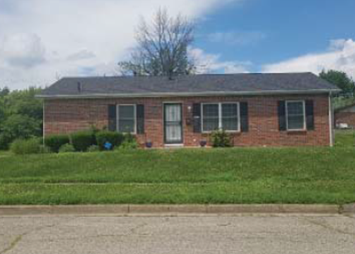
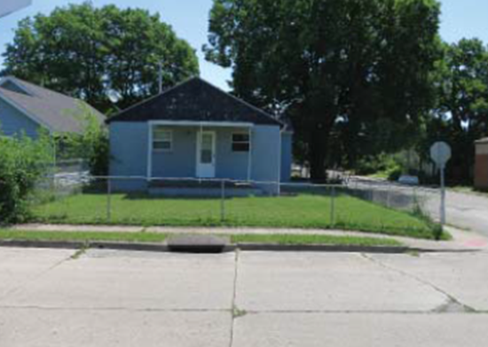
Housing Goal #3
Develop a menu of housing programs to encourage investment, attract other homeowners to the community, and stabilize current homeowners
Objective: Develop home improvement loans and homeownership opportunities in Greater Miami Chapel
  Activities:
  80-120% AMI targeted home loan program
  Special homeownership loan incentive products
  Down payment assistance programs

Slide 15
Housing Goal #4
Increase environmental sustainability and create a place for healthy living
Objective 1
Ensure all new construction is built with high-quality, sustainable, high-efficiency components
Objective 2
Improve the energy efficiency and the health of existing owner-occupied homes through comprehensive rehabilitation
Activities:
Use well rated materials in new construction Energy-Star rated appliances
Evaluate the feasibility of using renewable energy sources to lower costs
Activities:
Identify children tested for elevated blood lead levels and target associated homes for lead abatement
Offer comprehensive rehabilitations on homes where feasible

Slide 16
VISIONS

Slide 17
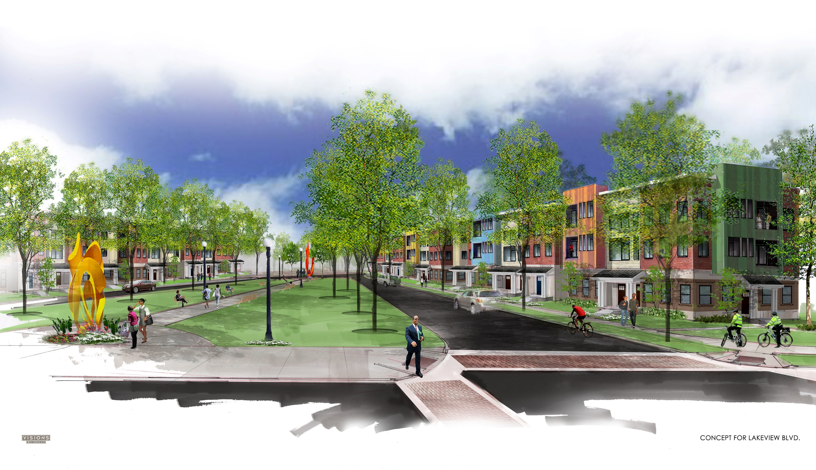
Notes:
Selections from visioning party, tried to match desires with current neighborhood aesthetic and potential budget

Slide 18
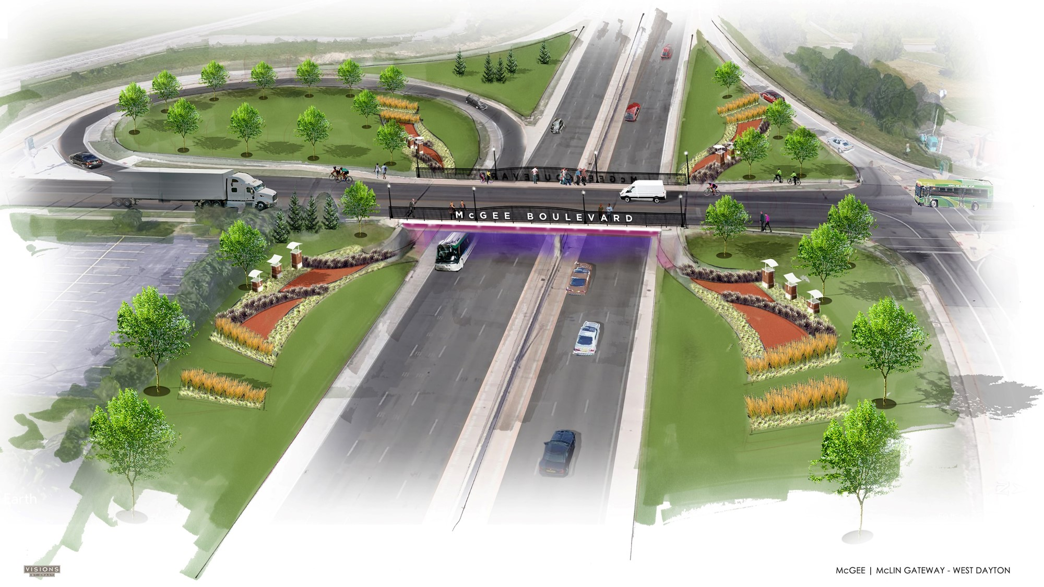
Notes:
-Create town center feel with mixed use buildings and creation of public plaza spaces; -Activate Germantown by providing options for places for people to go and shop/work/eat/live; visit the amenity preference table to provide input on what types of service amenities should go there

Slide 19
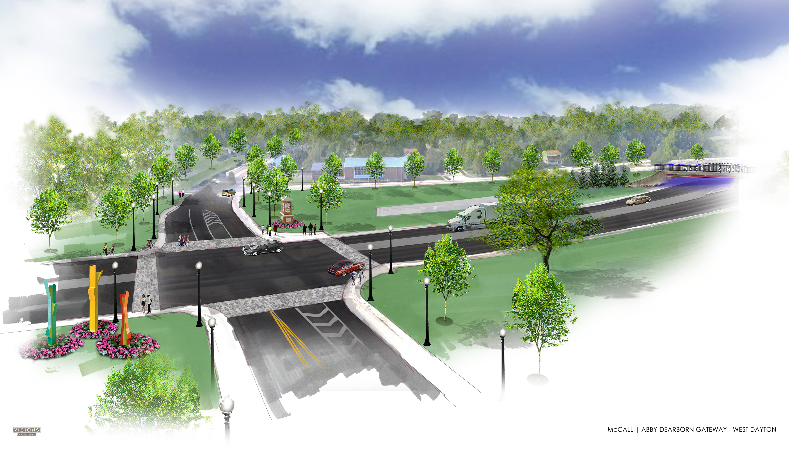
Notes:
-Create town center feel with mixed use buildings and creation of public plaza spaces; -Activate Germantown by providing options for places for people to go and shop/work/eat/live; visit the amenity preference table to provide input on what types of service amenities should go there

Slide 20
Next Steps
Action Activities
Determine timing for Choice Implementation
Fund development
Continue to refine the Plan

