Slide 1
Notes:
Introduce what we’re going to tell them, generally about Choice Neighborhood Dayton at a high level, the challenges, the process, how the community has been involved and what we’ve derived from that participation as well as next steps.

Slide 2
Choice Neighborhoods – What is it?
Federal program to improve neighborhoods with large scale public housing developments
Awarded June 2016
GDPM and City of Dayton applied for funds along with 64 applicants. 8 grants were awarded. The community received the largest amount awarded of $1.5 million.
Over 25 local partners provided cash/in-kind
CityWide hired as Planning Coordinator
Program began, October 2016

Slide 3
GDPM
Affordable Housing
GDPM owns 863 housing units in West Dayton
Of these, 41% are located in the Choice Neighborhood areas
GDPM has invested $7M in capital improvements to its inventory.
Development
Strategic Demolition: 52 obsolete units in Hilltop Homes
Germantown Village: new construction, $1.45M capital investment
Special Initiatives
Family Self-Sufficiency Program
JOBS PLUS

Slide 4
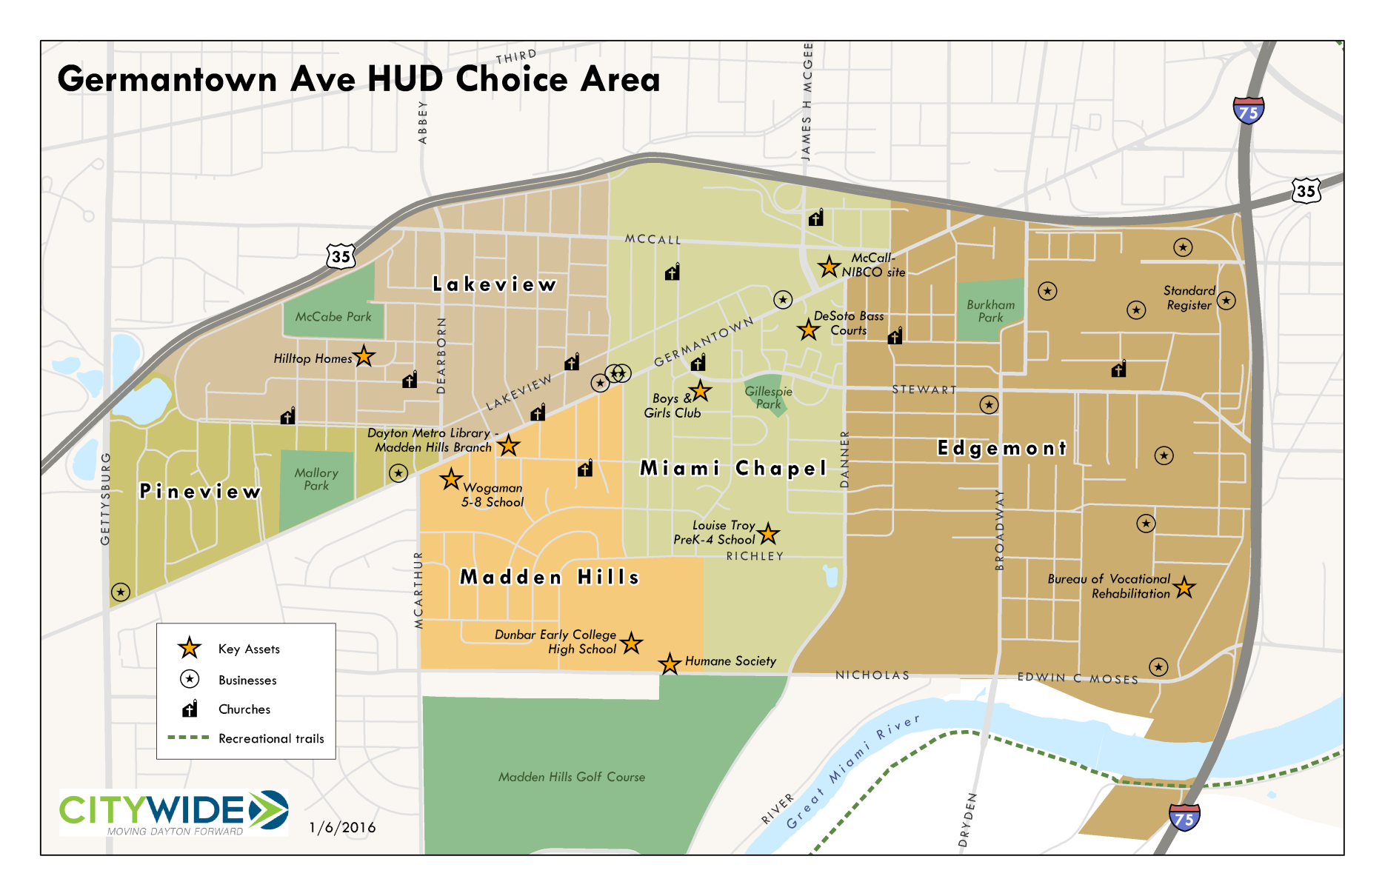
Map

Slide 5
Choice Neighborhoods Goal
Goal: with residents and community stakeholders, create a transformation plan that improves the lives of the people who live here.
Plan must have strategies to address:
people – social services, schools, jobs,
housing – high quality, affordable to a variety of incomes
neighborhood – physical environment, streets, amenities, condition of structures, transportation network.

Slide 6
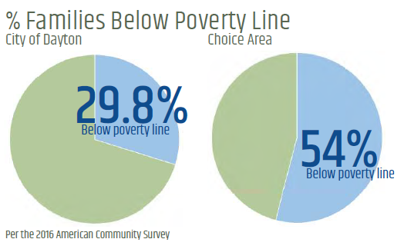
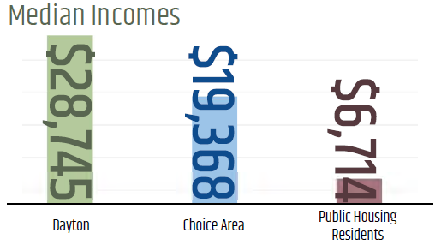
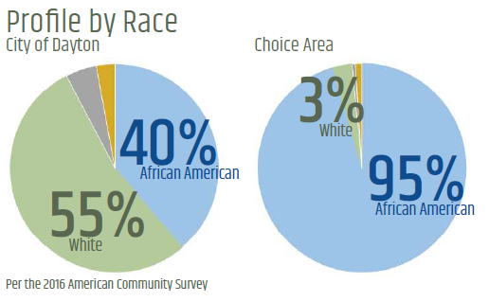
Choice Neighborhood Profile
Dayton Population: 141,143
Choice Population: 6,240

Slide 8
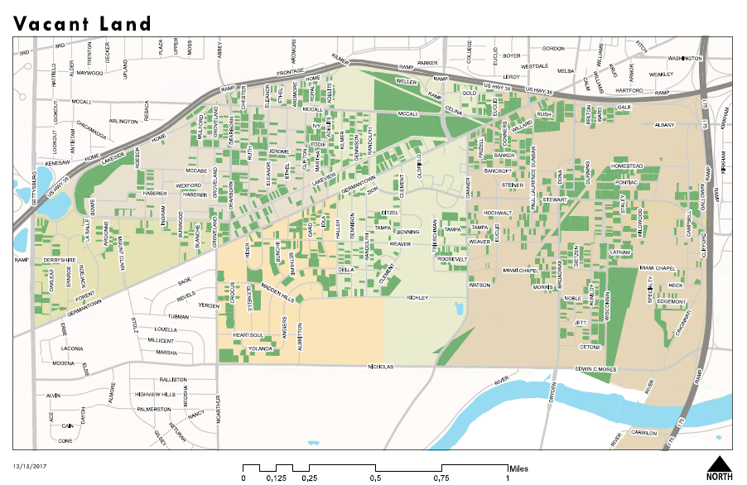
Notes:
This is vacant land
Not structures

Slide 9
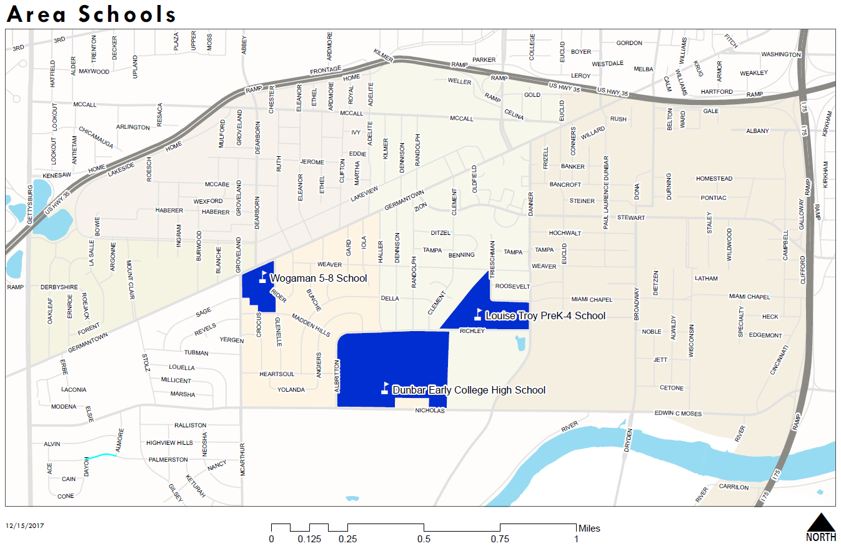

Slide 10
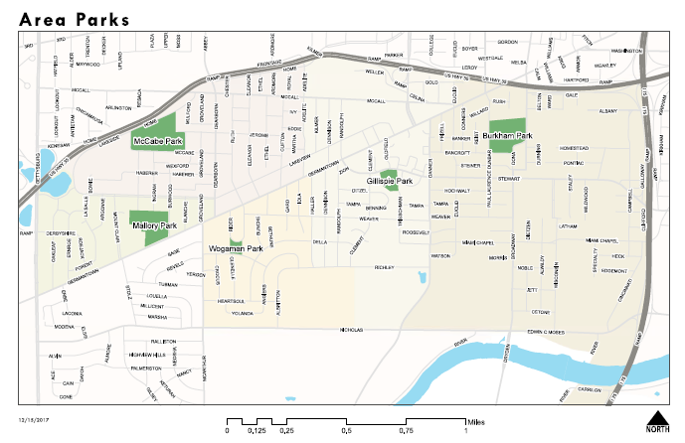

Slide 11
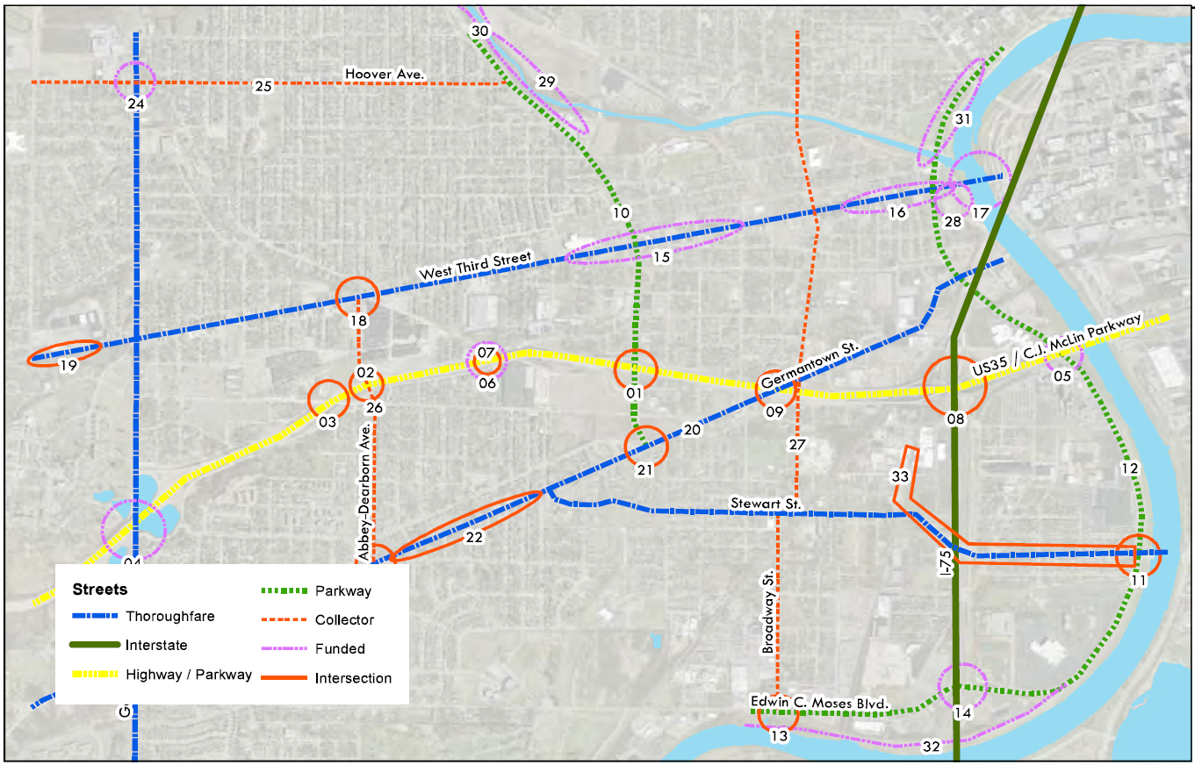
West Dayton Corridor Plan

Slide 12
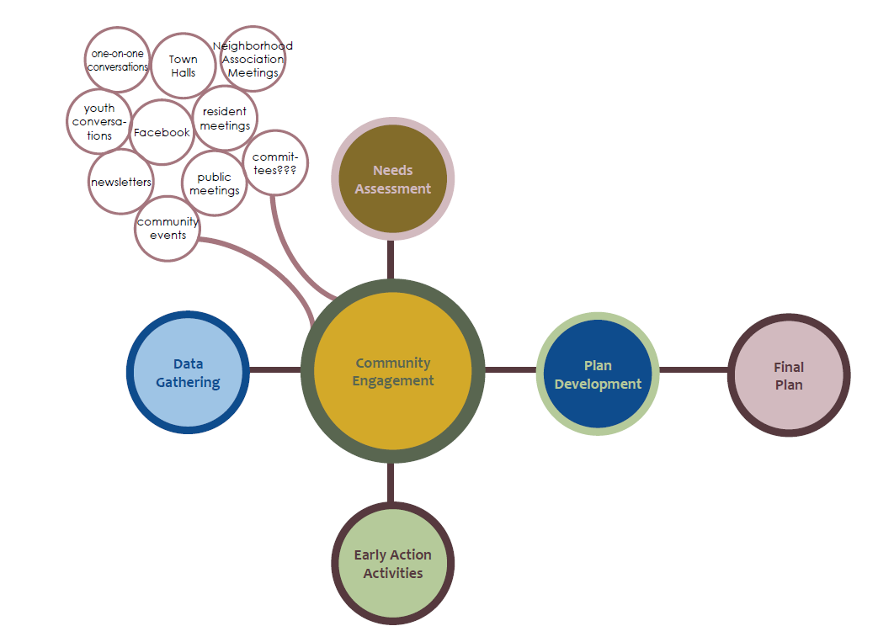
The Process

Slide 13
What are the needs?
Household Needs Assessment (Public Housing Residents)
Community Assessment (Broader Neighborhood):
179 of 441 heads of households (40.6%) participated
Transportation is #1 barrier to work, also listed as top asset
Top retail needs: grocery store, laundromat
Safety: Most concerned about safety and want stronger police presence
65% said there were times when there was not enough food in the house
62% interested in on site community gardens
Of respondents with preschool children, all are using high quality preschools. However, of those in primary education most attend schools outside of neighborhood
78 participants
Most were retired or disabled participants
Top retail needs: grocery, restaurants, farmers market
Most felt safe, majority desire more visible police patrol (69%)
Only 21% indicated there were times when there was not enough food
55% interested in community garden
Notes:
After a year on the ground what have we learned.? Suggestion: during remarks note that highlighted items were verified through recent community visioning activity.

Slide 14
What Does the Data Say about Housing?
Housing Market Study
Key Findings Related to Demand
Market Rate (Family/Senior) 70-100 units
LIHTC (Family) 140-190 units (40-60% AMI)
LIHTC (Senior) 50-70 units (40-60% AMI)
Subsidized units (Family) 240-320 units (below 30% AMI)
Subsidized units (Senior) 180-260 units (below 30% AMI)
For Sale units, any 20-55 (80-120% AMI)
Desired Amenities for housing
Central Air
Dishwasher, microwave, stove, refrigerator
Ceiling fans
Washers/dryers on site or in units;
Connectivity
Walkable
Green space
Recreation
Retail options
Well lit
Notes:
Projections of what market can support by 2020
(from organizing work and surveys)
kp

Slide 15
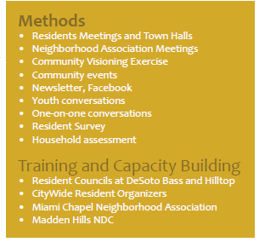
Community Engagement
Over 300 people engaged through community meetings and events
Resident Councils Formed: Hilltop Homes and Desoto Bass
Regular engagement with established neighborhood groups in Pineview and Madden Hills
Notes:
Karen

Slide 16
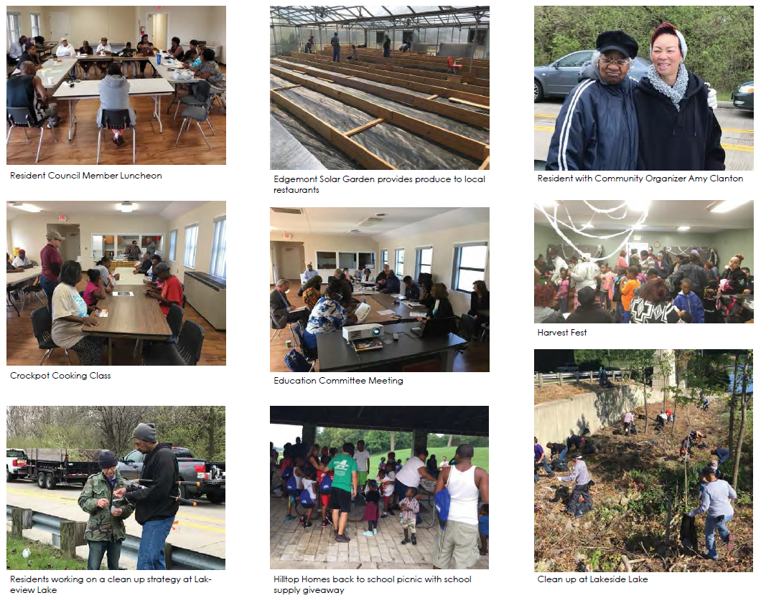
Notes:
Karen

Slide 17
Early Action Activities

Slide 18
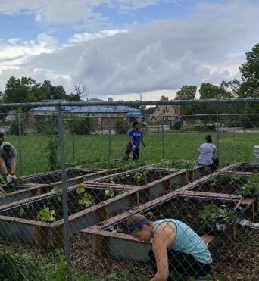
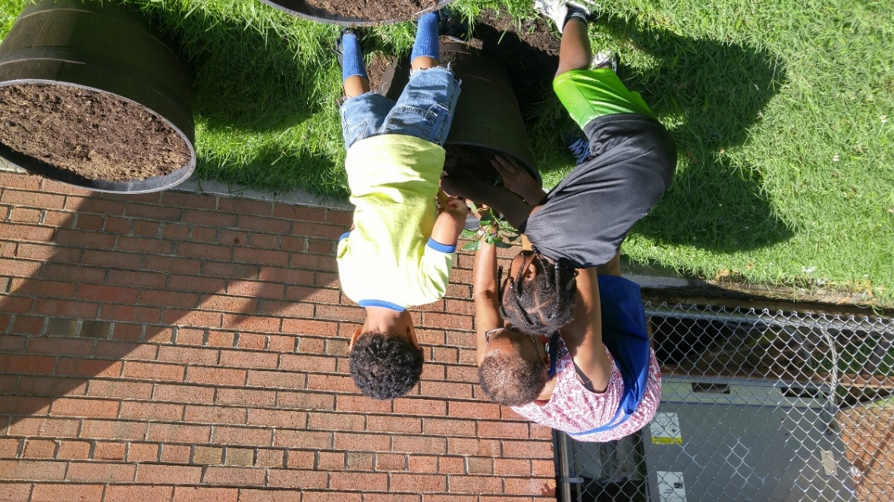
Community Gardens
Notes:
DeSoto Bass Community Garden- with leverage funding from Citywide. The logo and name were created and voted on by residents
kp

Slide 19
Lakeside Restoration
Partners
CityWide
Pineview Neighborhood
GDPM
COD
State AFL-CIO
Union Sportsmen Alliance
Dayton VA
Garden Club of Dayton
UD River Stewards

Slide 20
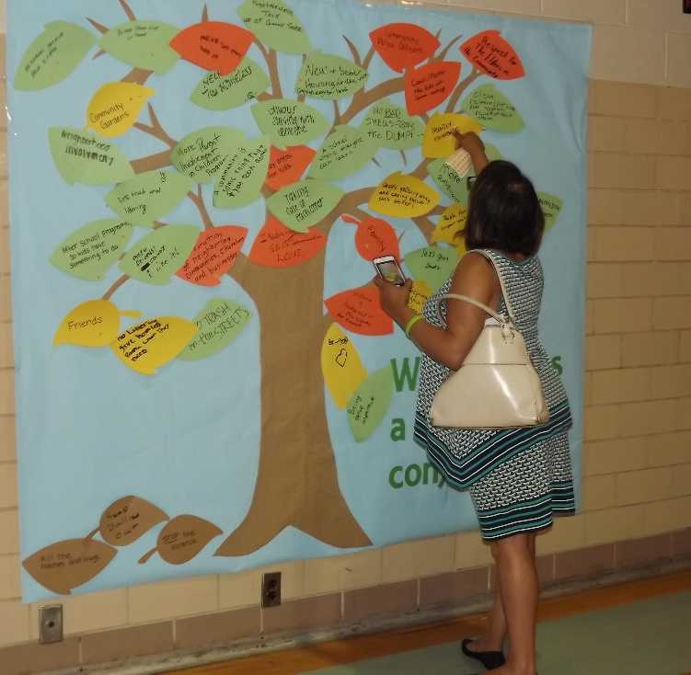
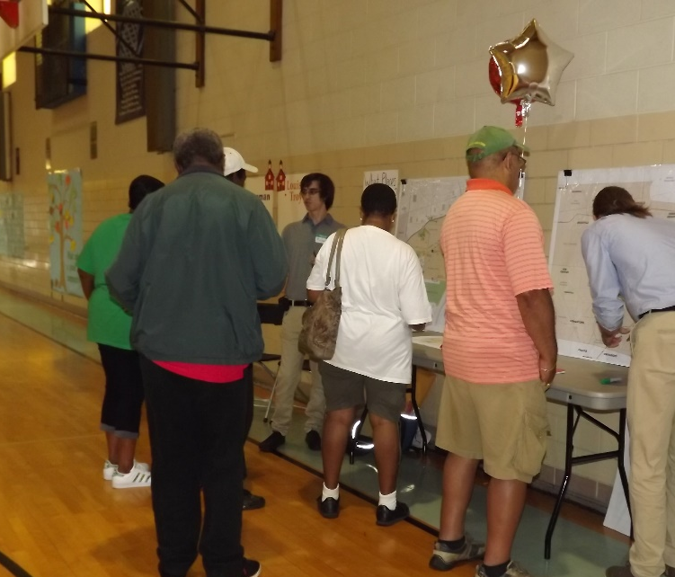
Community Visioning Party
September 2017:
Visioning / Consensus building
Notes:
Event was held on September 21 to share results of nine months of planning and organizing in a fun way with residents. Over 100 people attended. Goal: where is there consensus? What is most important.

Slide 21
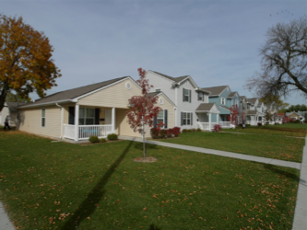
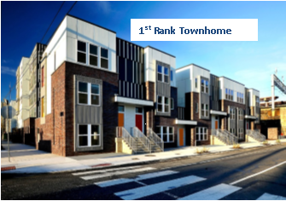
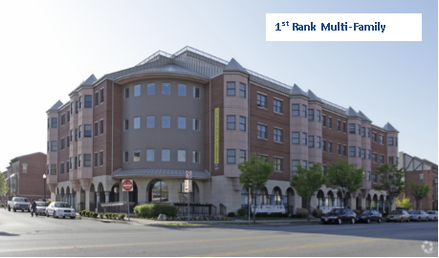
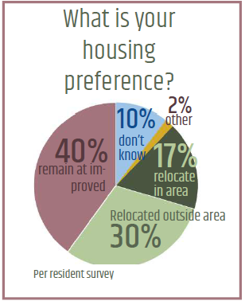
Community Housing Preferences
Family Housing Category
September 2017:
Visioning / Consensus building
Notes:
Suggestion: during remarks note that highlighted items were verified through recent community visioning activity.

Slide 22
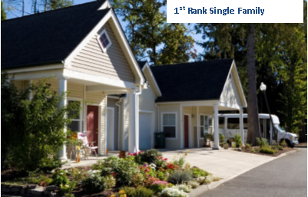
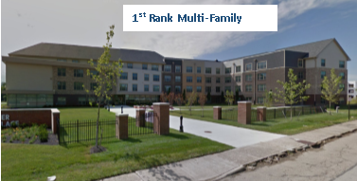
Community Housing Preferences
Senior Housing Category
Notes:
Suggestion: during remarks note that highlighted items were verified through recent community visioning activity.

Slide 23
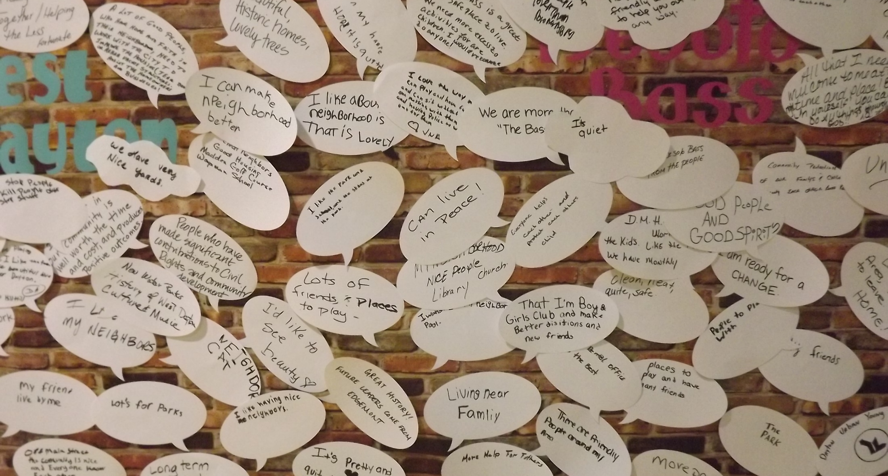
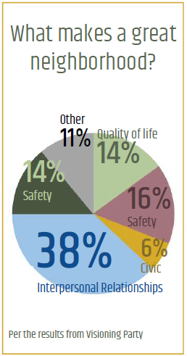
Community Identity
Notes:
Negative West Dayton perception needs to change
People don’t want to live on top of one another
People are proud to live here
People want better local retail/service options

Slide 24
Notes:
Suggestion: during remarks note that highlighted items were verified through recent community visioning activity.

Slide 25
WE’LL BE BACK TO SHARE MORE DETAIL IN THE COMING MONTHS
Due Date: June, 2018
Thank you
Notes:
Suggestion: during remarks note that highlighted items were verified through recent community visioning activity.

