Slide 1
Choice Neighborhoods Town Hall Meeting
February 8, 2017

Slide 2
Choice Neighborhood Town Hall
AGENDA
Welcome
Introduce Team
Goals for tonight
Review Choice process
Household Assessment Results
Discussion
Work Groups
Next Steps
Share neighborhood survey link for broader input to the process.

Slide 3
Choice Neighborhoods
Goal: with residents and community stakeholders, create a transformation plan that meets the needs of people who live here.
Plan must have strategies to address:
people – social services, schools, jobs,
housing – high quality, affordable to a variety of incomes
neighborhood – physical environment, streets, amenities, condition of structures, transportation network.

Slide 4
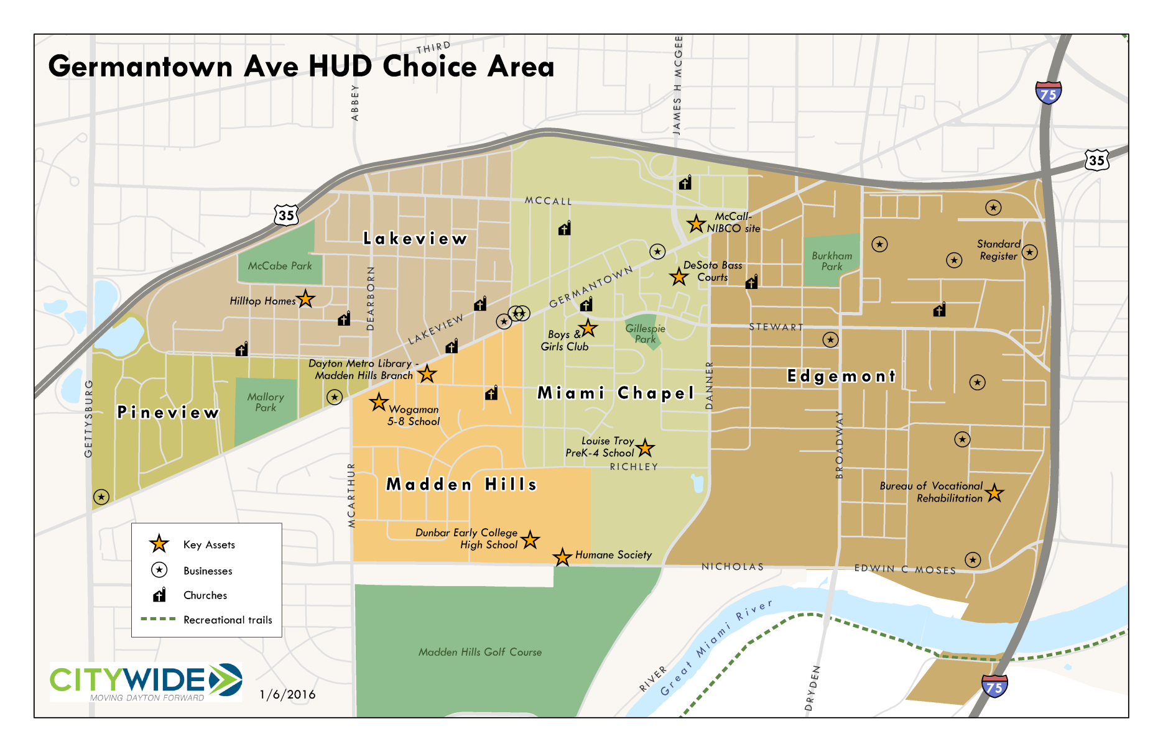
Choice Geography
Map

Slide 5
How does Choice impact me?
The local effort recognizes that each neighborhood is unique and has different needs.
Choice team doing “micro planning” at neighborhood level with established neighborhood groups and building groups where none exist.
Goals:
provide resources, technical assistance now to improve neighborhoods during planning process.
create transformation plan and seek adoption by HUD to garner resources to improve the entire community.

Slide 6
What Are THE ISSUES? What are the Interests? DeSoto BASS AND HILLTOP RESIDENT SURVEY
Richard Stock, PhD.
Director, Business Research Group
University of Dayton

Slide 7
Who filled out the Survey
133 People at DeSoto Bass and 46 people at Hilltop
How long have you lived at DeSoto Bass / Hilltop?
Half of the people talked to had lived here less than 3 years.
25% of the people talked to lived here more than 9 years
While about half were living by themselves, 78 of the 179 people responding had children
42% want to live at DeSoto Bass/ Hilltop as long as they can and another 17% plan at least 2 more years
Slightly more than half, (59%), are “Very” or “Somewhat” Satisfied with living at DeSoto Bass / Hilltop

Slide 8
Employment Issues: only 22% Are Employed and ONLY 11% Are EMPLOYED Full-time

Slide 9
Employment Interests: What type of job are you interested in?

Slide 10
Employment Barriers: What are the employment barriers in your neighborhood?

Slide 11
What SERVICES WOULD HELP: Services needed to assist residents to become employed:
Transportation | 67%
Job Skills Training | 54%
After school child care | 38%
Job Fairs | 33%
Before school child care | 22%
6% are currently attending college or
vocational training BUT 46% would like to

Slide 12
WHAT SKILLS: What types of skill development training would most benefit the adult(s) in your household?
Computer Skills | 56%
Cooking/food preparation | 39%
Budgeting/finances | 38%
Small business training | 32%
Relationship skills | 32%
Leadership training | 26%
Child development/parenting | 20%
College prep | 20%
Vocational training | 16%
English skills | 8%
Citizenship | 8%

Slide 13
Computer Use: Only 25% have a computer at home And 75% of that group Can Access the INTERNET
Use the computer/internet to
Search the internet or do research | 62%
Type resume or other materials for a job | 61%
Practice computer skills | 53%
Send and receive email | 50%
For school work or homework | 44%
For entertainment and/or to play games | 41%
Access information about my child's school record | 29%
For other reasons | 12%

Slide 14
Where Do YOU Use the Computer/ Internet?

Slide 15
TRANSPORTATION ISSUES: Is transportation a barrier when trying to get to work, school, the grocery store, the doctor, or other places?
UNLESS THEY HAD THEIR OWN CAR, TRANSPORATION WAS A BARRIER. ONLY 21% HAD THEIR OWN CAR

Slide 16
Banking ISSUES: Only 38% have Checking Accounts
Without a Car, regular banking is less likely

Slide 17
Usual Grocery: People Shop Close TO HOME without a CAR
Families with their own car were more likely to get the 5 daily servings of fruits & vegetable, (29% vs. 12% Adults, 33% vs 20% Children)

Slide 18
Food: Are there times when there isn't enough food in the house to eat? 65% Said “Yes”
62% of families were interested in a community garden on-site at DeSoto Bass \ Hilltop. All of them said they were willing to help maintain it. Many families use the summer lunch program, (42%)

Slide 19
Health Issues
Good News: 90% have health insurance for them and their children and 84% indicated they had access to quality affordable healthcare for themselves and their children
Bad News: There are Health Issues for a substantial minority of adults, (11% in “Poor” and 37% in only “Fair” health

Slide 20
Children
Just under half have children at home, (46%)
Schools Attended are Widely Scattered
High School (10 at Belmont, 9 at Dunbar, 5 at Thurgood Marshall, 2 at Meadowdale, 2 at Ponitz, 1 at Stivers, 1 at DECA, 1 at Trotwood)
Elementary (City Day 9, Dayton Leadership 6, DECA 3, EJ Brown 4, Edison 7, Horizon 5, Imagine 2, Louise Troy 7, Pathways 3, Rosa Parks 2, STEAM Academy 2, Valerie 6, Westwood 3, Wogaman 3, WOW 1
Most preschoolers are at MVCDC (Hilltop, Kings Highway, Rosa Parks)
70% are happy with their children's’ schools but 20% are not
If preschool/child care were offered on-site would you use it? 69% said they would

Slide 21
Do your children participate in any of the following enrichment programs/activities?
Children don't participate | 38%
Church activities | 20%
Sports/recreational activities | 20%
Dayton Metro Library | 14%
Tutoring | 14%
Boys & Girls Club | 10%
Potter's House | 10%
Dakota Center | 6%
Greater Dayton Recreation Center | 5%
After school programs | 5%
Mentoring | 4%
Leadership | 4%

Slide 22
What activities would you like to see in your neighborhood for children and youth?
Recreation/Sports | 72%
Art/Dance/Music/Singing | 57%
Social Activities | 52%
Youth Leadership | 47%
Drug Prevention | 47%
Academic Tutoring | 46%
Job skills training/employment assistance | 46%
Mentoring | 42%
Life Skills/financial literacy | 35%
Computer Classes | 30%
Internships | 19%

Slide 23
What Services WOULD Most Benefit Family

Slide 24
Speaking of Recreation: If there were a park in the area what features would you most like to have there?

Slide 25
Safety Issues: What are the safety concerns in your neighborhood or surrounding area?
42% of respondents feel unsafe during the day and 69% feel unsafe after dark in the neighborhood

Slide 26
Ideas for Crime Prevention: What Crime prevention activities could be successful in your neighborhood

Slide 27
Dayton Police Department: How could the Dayton Police Department improve services in your neighborhood?
Just over 50% of residents had ‘some” or “ a lot of” trust in the Dayton Police Department

Slide 28
Neighborhood Strengths: What do you consider to be the strengths of your neighborhood?
Almost Everyone, (89%) Could List Some Strengths of the Neighborhood

Slide 29
Neighborhood Dislikes: What are the things you don't like about this neighborhood?

Slide 30
What types of businesses or services would you like to see in your neighborhood?

Slide 31
Disability Issues: What do you see as the most important issues affecting you or the disabled persons that you know
More than half of those with Disabled in House feel there are not enough supports in Neighborhood for Disabled

Slide 32
DISABLED SERVICES What services would help you in your current living situation?
A THIRD of THE DISABLED INDICATED NO ADDITIONAL SERVICES WERE NEED

Slide 33
Senior Issues: Important issues affecting the seniors that you know

Slide 34
Senior Services: What services would help the senior in his/her current living situation?

Slide 35
Discussion
Household Assessment is one tool to deepen our understanding
What do the results tell us?
What needs further discussion and study?
List Topics
Who wants to help?
Please sign up on poster board sheets.
Staffed by Choice Organizers at Front of room.

Slide 36
What’s ahead?
Physical Design
Housing market study to determine demand
Architectural design/development concepts for housing
What do people want? Types.
Senior cottages, own their own home, attached townhouses etc.?
What can people afford? HUD says mixed income? What does that mean in Dayton, Ohio?
Repositioning neighborhood assets, ie. parks
Recommendations to streets and infrastructure
How should new housing be better connected to neighborhood amenities and transportation network
Replacement of public housing
HUD Requirement: 1:1 housing replacement
Available land for housing development in West Dayton could easily accommodate anyone who does not want to leave the community.

Slide 37
Choice Communication
Current Strategies
Choice newsletter
Sharing information in other groups newsletters
In Development
Website
Facebook page – in development
One to One meetings with Choice Community Organizers
What else should we be doing?
Notes:
Maybe do this at the end?

Slide 38
Thank you for attending!
Mailing List
If you are not on our mailing list, please complete a card and return at the end of the meeting.
Neighborhood Survey Link, via Survey Monkey
https://www.research.net/r/HUDChoiceNeighborhood
Pick up a slip with a link on the way out
Prefer a paper copy? Pick up at the end of the meeting
Want to talk further with a Choice Community Organizer?
Contact:
Amy Clanton, 853-2537, Aclanton@citywidedev.com
Karen DeMasi, 853-2555, Kdemasi@citywidedev.com

